Slide 1
Topic 5 – Big O Notation

Slide 2
Algorithm Efficiency
Throughout the course we will seek to design efficient algorithms
But how can we come up with a universal standard for algorithm efficiency?
Imagine I compare my dice program with yours
I run my program on my fast office computer
You run your program on a slower lab machine
my computer
your lab machine

Slide 3
Running Times
5 Dice rolled 1 million times
Which Dice algorithm is better?
Mine or yours?
This comparison is unfair because the performances of the two computers are different
 | Running Time
My computer | 40ms
Your computer | 1000ms
my computer
your lab machine

Slide 4
The metre
Historically, (1889-1960) the metre was defined by the French Academy of Sciences
It was the length between two marks on a platinum-iridium bar
1/10 millionth of the distance from the equator to the North Pole through Paris
Every measurement was based on this bar

Slide 5
Algorithm Efficiency
In the same way, we could try running all algorithms on the same computer
But is this a good universal standard?
We would need to have a single benchmark machine on which all of the world’s programs were tested
386 25Mhz with 2MB RAM
This machine would quickly become antiquated and need to be updated, invalidating the previous measurements

Slide 6
Running Times
Which Dice algorithm is better?
Mine or yours?
This comparison is unfair because the performances of the two computers are different
 | 1 million rolls | 2 million rolls | 3 million rolls
My computer | 40ms | 160ms | 360ms
Your computer | 1000ms | 2000ms | 3000ms

Slide 7
Standard measure
The relationship between the increase in the size of a problem and the increase in the running time is platform independent (apart from a constant)
No matter what platform you run it on, the same relationship will emerge
We therefore use this relationship to define algorithm efficiency
Knowing the relationship is very useful for predicting how long an algorithm will take to run on a particular problem

Slide 8
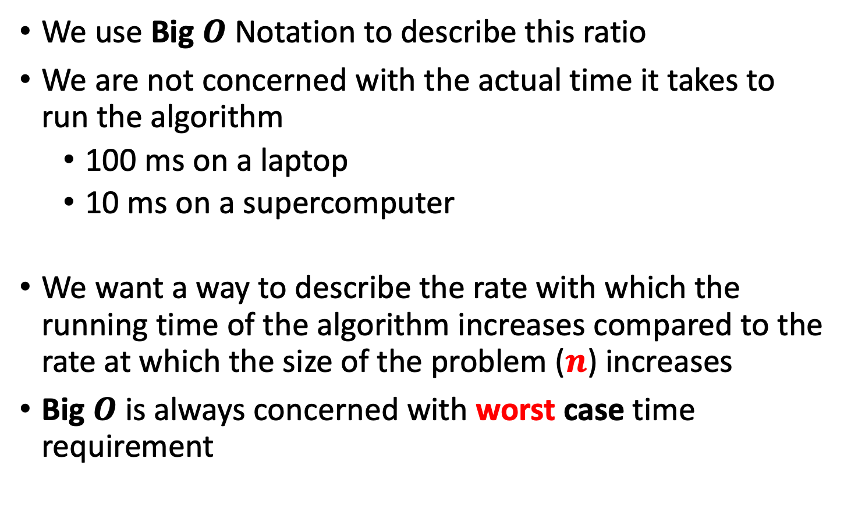
Big O Notation
We use Big $O$ Notation to describe this ratio
We are not concerned with the actual time it takes to run the algorithm
100 ms on a laptop
10 ms on a supercomputer
We want a way to describe the rate with which the running time of the algorithm increases compared to the rate at which the size of the problem ($n$) increases
Big $O$ is always concerned with worst case time requirement

Slide 9
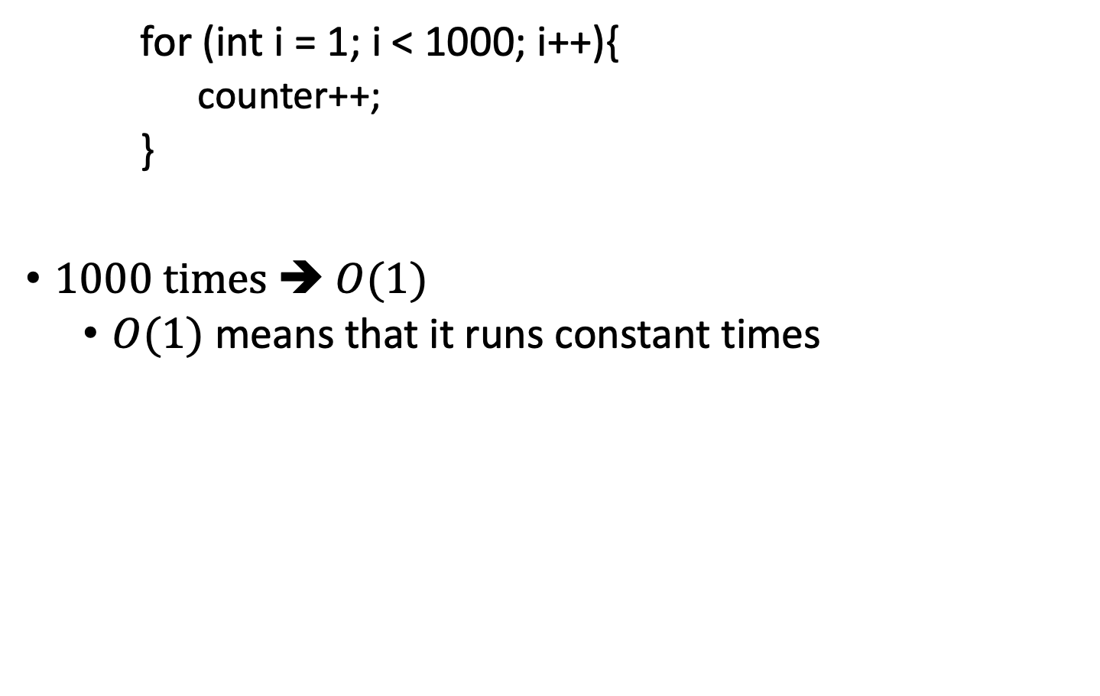
Example 1.
for (int i = 1; i < 1000; i++){
counter++;
}
$1000$ times ➔ $O(1)$
$O(1)$ means that it runs constant times
// Run 1000 times

Slide 10

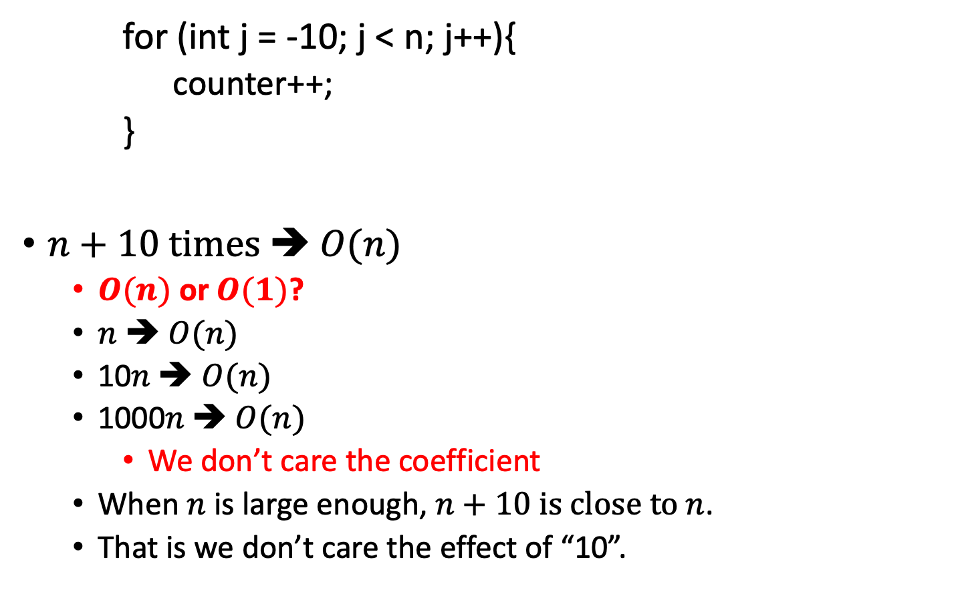
Example 2.
for (int j = -10; j < n; j++){
counter++;
}
$n+10$ times ➔ $O(n)$
$O(n)$ or $O(1)$?
$n$ ➔ $O(n)$
10$n \text{➔ }O(n)$
1000$n \text{➔ }O(n)$
We don’t care the coefficient
When $n$ is large enough, $n+10$ is close to $n$.
That is we don’t care the effect of “10”.
// Run $n+10$ times

Slide 11

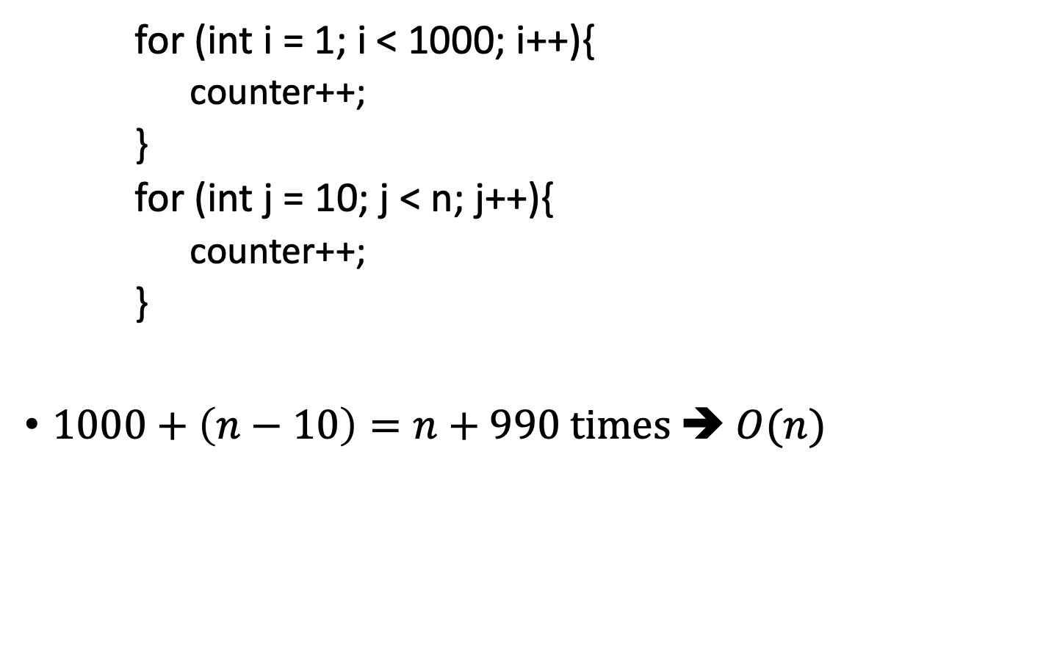
Example 3.
for (int i = 1; i < 1000; i++){
counter++;
}
for (int j = 10; j < n; j++){
counter++;
}
$1000+\left(n−10\right)=n+990$ times ➔ $O(n)$
// Run 1000 times
// Run $n−10$ times
Only look at the highest order

Slide 12

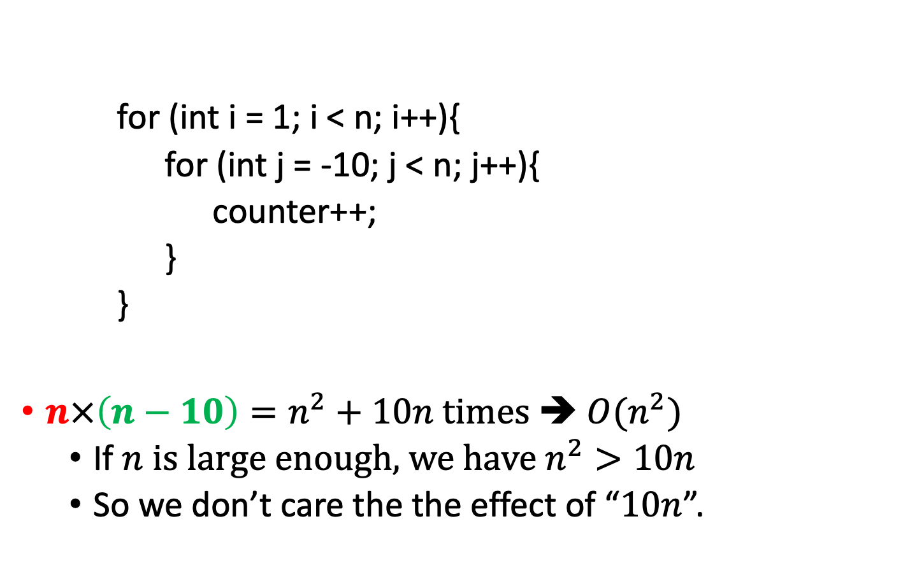

Example 4.
Only look at the highest order
for (int i = 1; i < n; i++){
for (int j = -10; j < n; j++){
counter++;
}
}
$n×\left(n−10\right)=n^{2}+10n$ times ➔ $O(n^{2})$
If $n$ is large enough, we have $n^{2}>10n$
So we don’t care the the effect of “$10n$”.
// Run $n$ times
// Run $n+10$ times

Slide 13
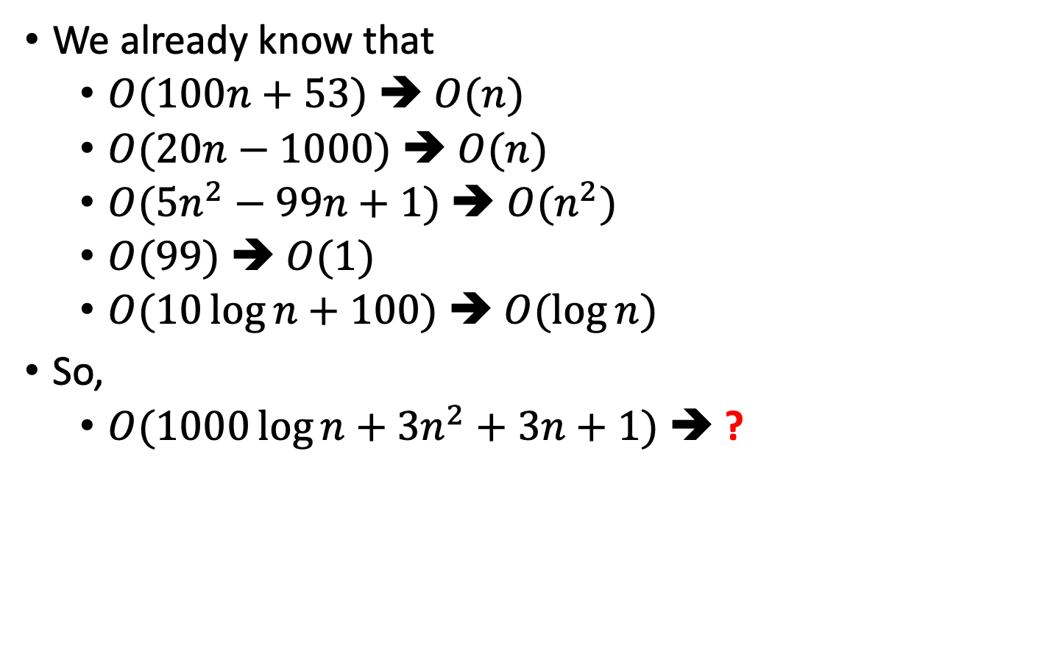
Question
We already know that
$O(100n+53\text{)}$ ➔ $O(n)$
$O(20n−1000)$ ➔ $O(n)$
$O(5n^{2}−99n+1)$ ➔ $O(n^{2})$
$O(99)$ ➔ $O(1)$
$O(10\log{n}+100)$ ➔ $O(\log{n})$
So,
$O(1000\log{n}+3n^{2}+3n+1)$ ➔ ?

Slide 14
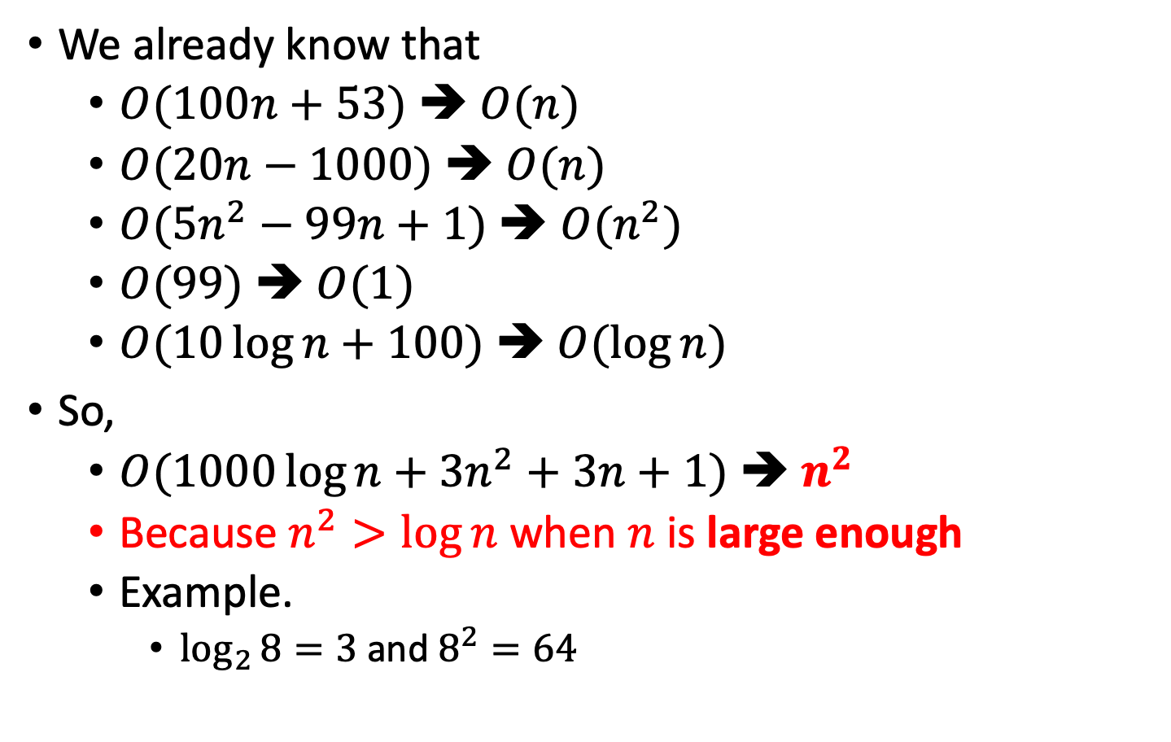
Question
We already know that
$O(100n+53\text{)}$ ➔ $O(n)$
$O(20n−1000)$ ➔ $O(n)$
$O(5n^{2}−99n+1)$ ➔ $O(n^{2})$
$O(99)$ ➔ $O(1)$
$O(10\log{n}+100)$ ➔ $O(\log{n})$
So,
$O(1000\log{n}+3n^{2}+3n+1)$ ➔ $n^{2}$
Because $n^{2}>\log{n}$ when $n$ is large enough
Example.
$\log_{2}{8}=3$ and $8^{2}=64$

Slide 15
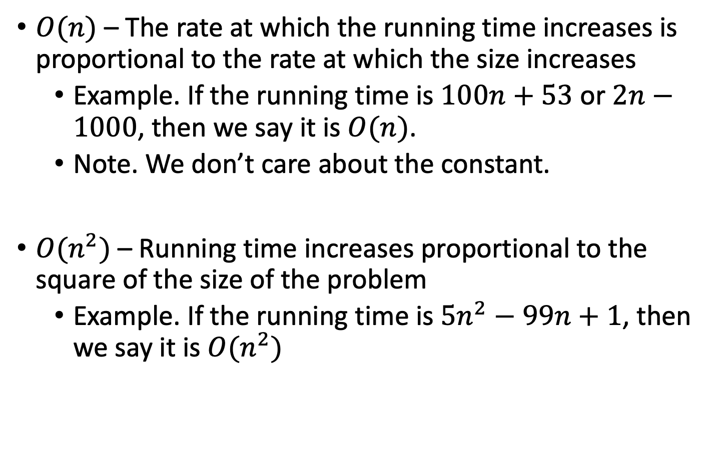
Examples
$O(n)$ – The rate at which the running time increases is proportional to the rate at which the size increases
Example. If the running time is $100n+53$ or $2n−1000$, then we say it is $O(n)$.
Note. We don’t care about the constant.
$O(n^{2})$ – Running time increases proportional to the square of the size of the problem
Example. If the running time is $5n^{2}−99n+1$, then we say it is $O(n^{2})$

Slide 16
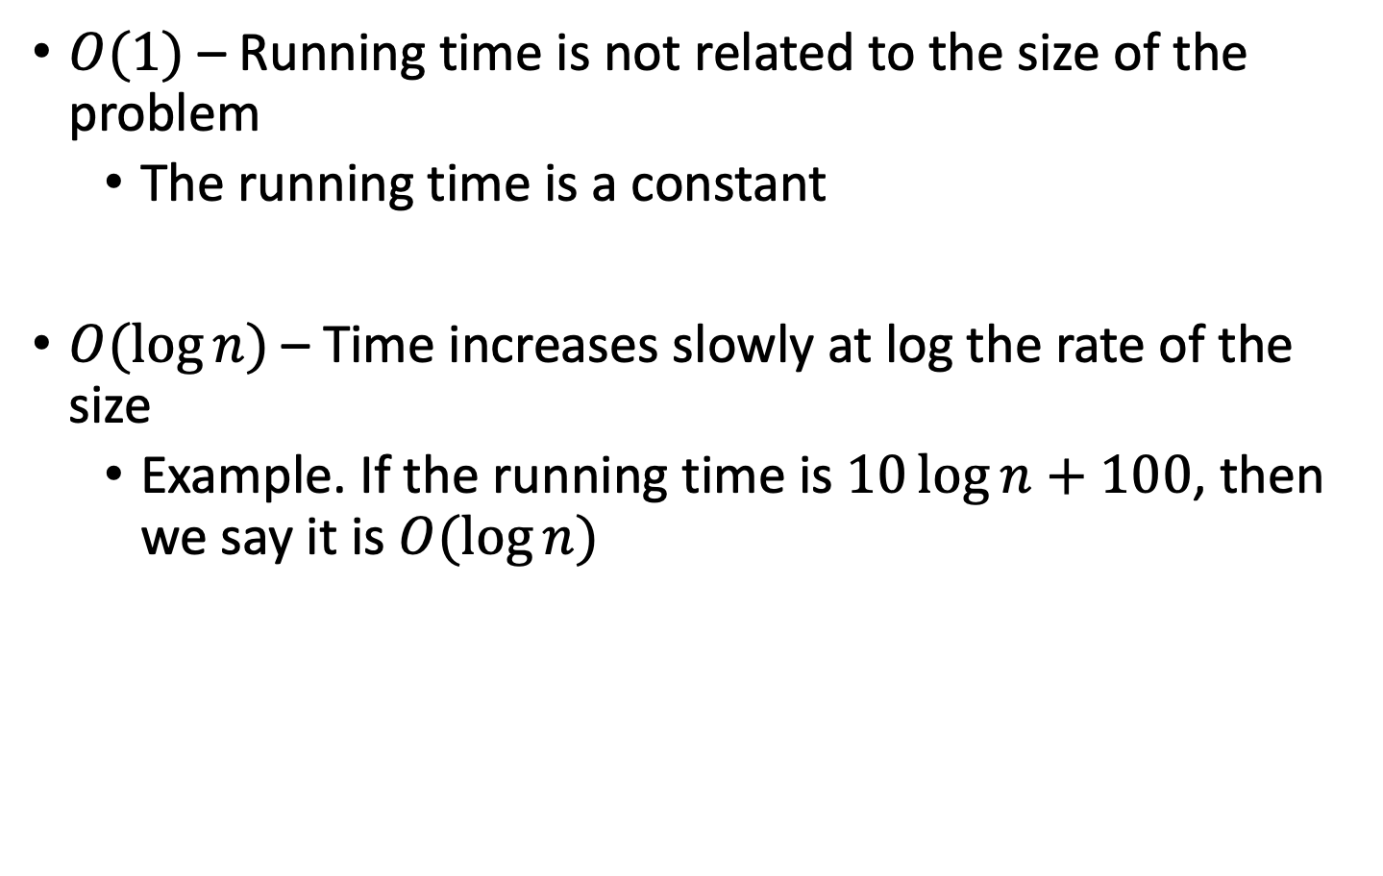
Examples
$O(1)$ – Running time is not related to the size of the problem
The running time is a constant
$O(\log{n})$ – Time increases slowly at log the rate of the size
Example. If the running time is $10\log{n}+100$, then we say it is $O(\log{n})$

Slide 17
Big O graph

Slide 18
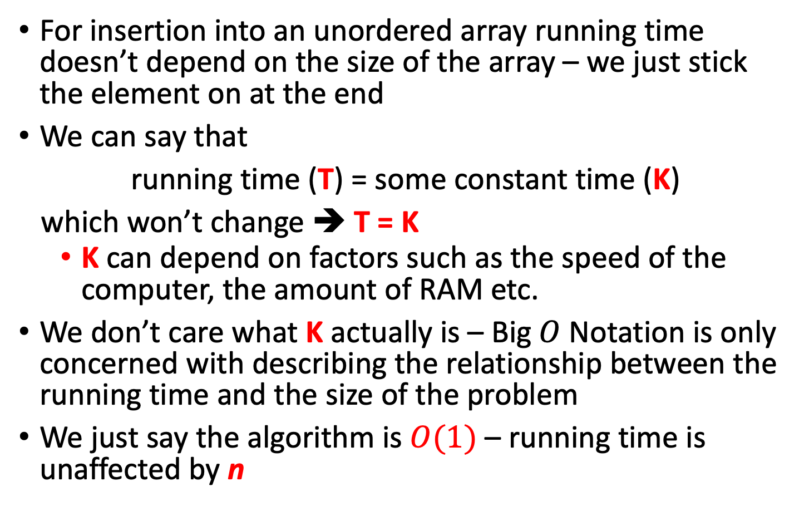
Insertion in an Unordered Array
For insertion into an unordered array running time doesn’t depend on the size of the array – we just stick the element on at the end
We can say that
running time (T) = some constant time (K)
which won’t change ➔ T = K
K can depend on factors such as the speed of the computer, the amount of RAM etc.
We don’t care what K actually is – Big $O$ Notation is only concerned with describing the relationship between the running time and the size of the problem
We just say the algorithm is $O(1)$ – running time is unaffected by n

Slide 19
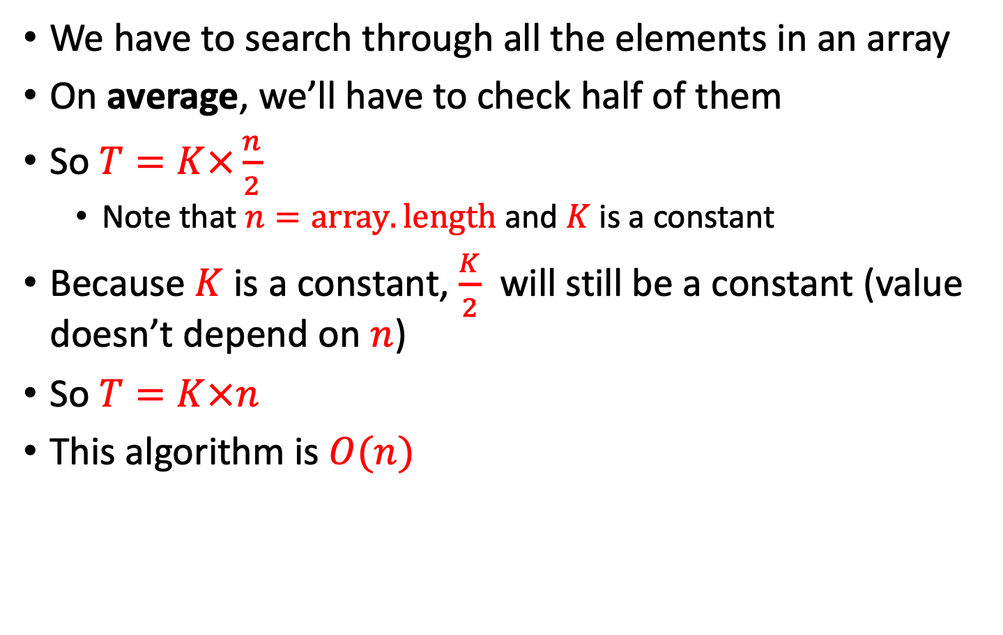
Linear Search
We have to search through all the elements in an array
On average, we’ll have to check half of them
So $T=K×\frac{n}{2}$
Note that $n=array.length$ and $K$ is a constant
Because $K$ is a constant, $\frac{K}{2}$ will still be a constant (value doesn’t depend on $n$)
So $T=K×n$
This algorithm is $O(n)$
//Linear Search
public int search (int searchKey) {
for(int j = 0; j < array.length; j++) {
if(array[j] == searchKey) { return j; }
}
return null;
}

Slide 20
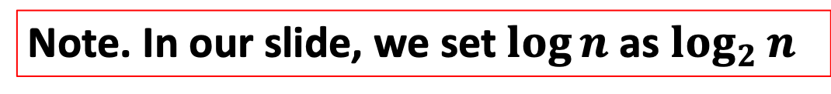
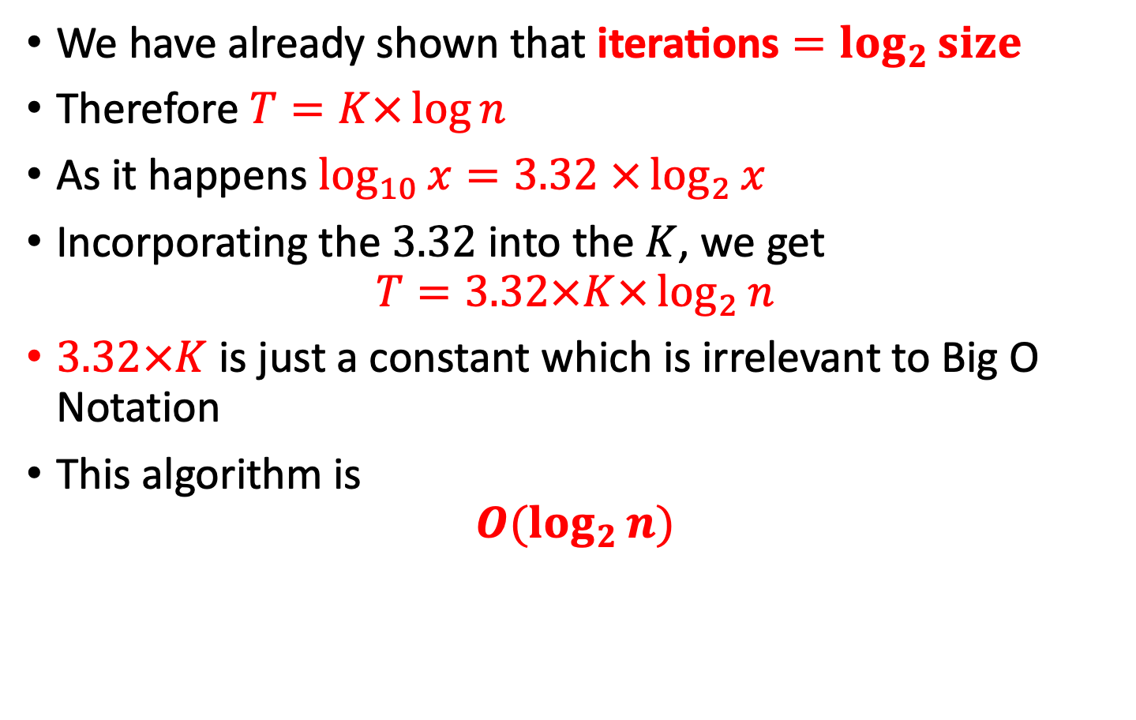
Binary Search
We have already shown that $\text{iterations}=\log_{2}{size}$
Therefore $T=K×\log{n}$
As it happens $\log_{10}{x}=3.32$ $×\log_{2}{x}$
Incorporating the $3.32$ into the $K$, we get
$$T=3.32×K×\log_{2}{n}$$
$3.32×K$ is just a constant which is irrelevant to Big O Notation
This algorithm is
$$O(\log_{2}{n})$$
Note. In our slide, we set $\log{n}$ as $\log_{2}{n}$

Slide 21
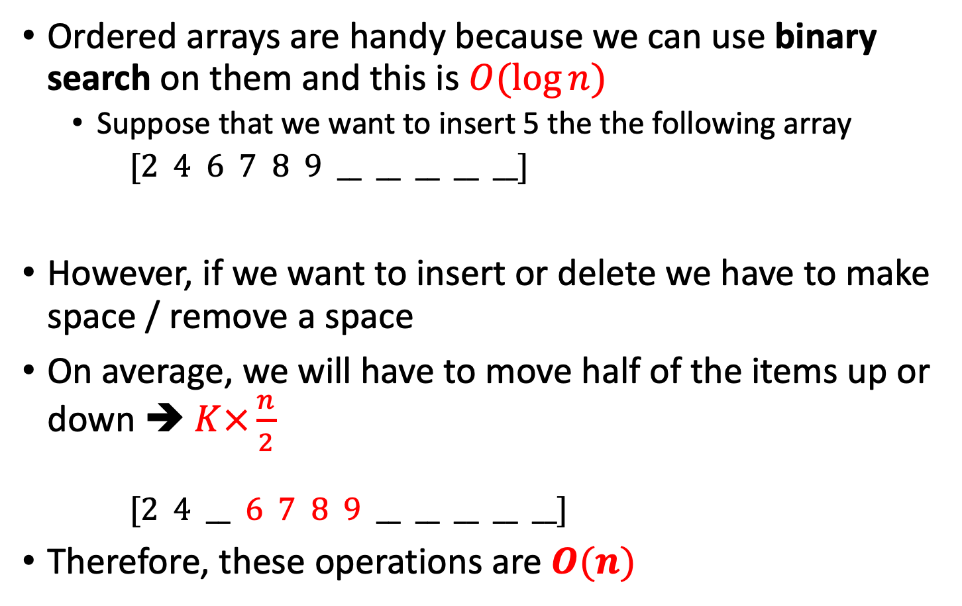
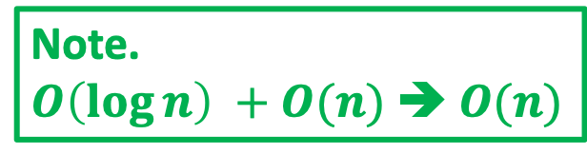
Operations in an Ordered Array
Ordered arrays are handy because we can use binary search on them and this is $O(\log{n})$
Suppose that we want to insert 5 the the following array
$[2 4 6 7 8 9 __ __ __ __ __]$
However, if we want to insert or delete we have to make space / remove a space
On average, we will have to move half of the items up or down ➔ $K×\frac{n}{2}$
$[2 4 __ 6 7 8 9 __ __ __ __ __]$
Therefore, these operations are $O(n)$
// We use $O(\log{n})$ to ensure that we can insert 5 at here
Note.
$O\left(\log{n}\right) +O(n)$ ➔ $O(n)$

Slide 22
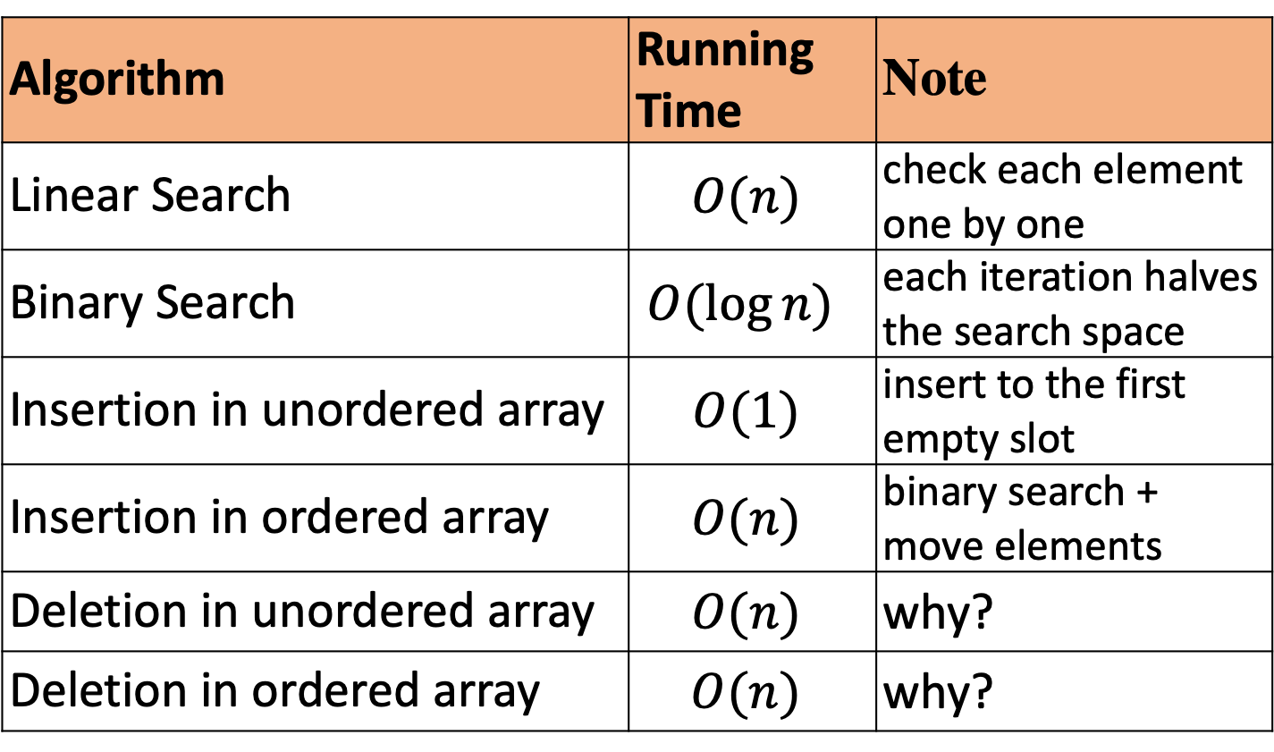
Running times in Big O Notation
Algorithm | Running Time | Note
Linear Search | $O(n)$ | check each element one by one
Binary Search | $O(\log{n})$ | each iteration halves the search space
Insertion in unordered array | $O(1)$ | insert to the first empty slot
Insertion in ordered array | $O(n)$ | binary search + move elements
Deletion in unordered array | $O(n)$ | why?
Deletion in ordered array | $$O(n)$$ | why?

Slide 23
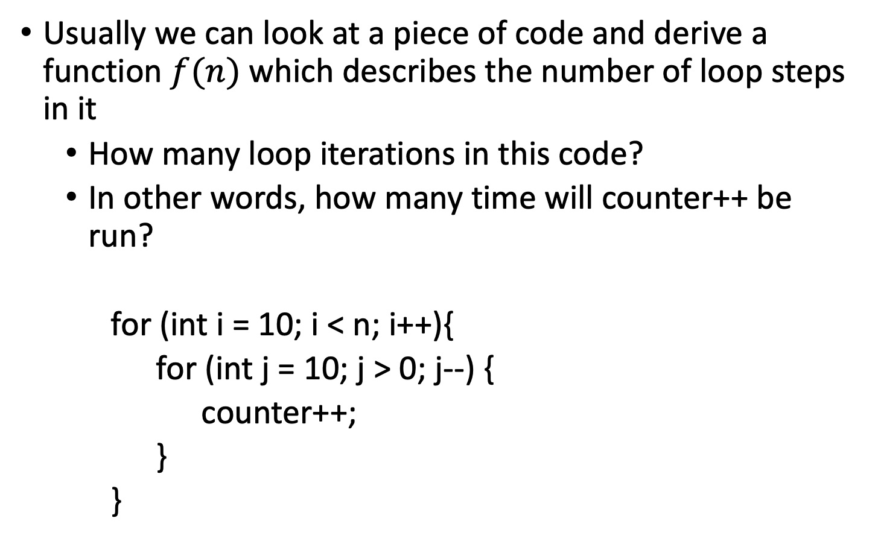
Expressing iterations in terms of n
Usually we can look at a piece of code and derive a function $f(n)$ which describes the number of loop steps in it
How many loop iterations in this code?
In other words, how many time will counter++ be run?
for (int i = 10; i < n; i++){
for (int j = 10; j > 0; j--) {
counter++;
}
}

Slide 24
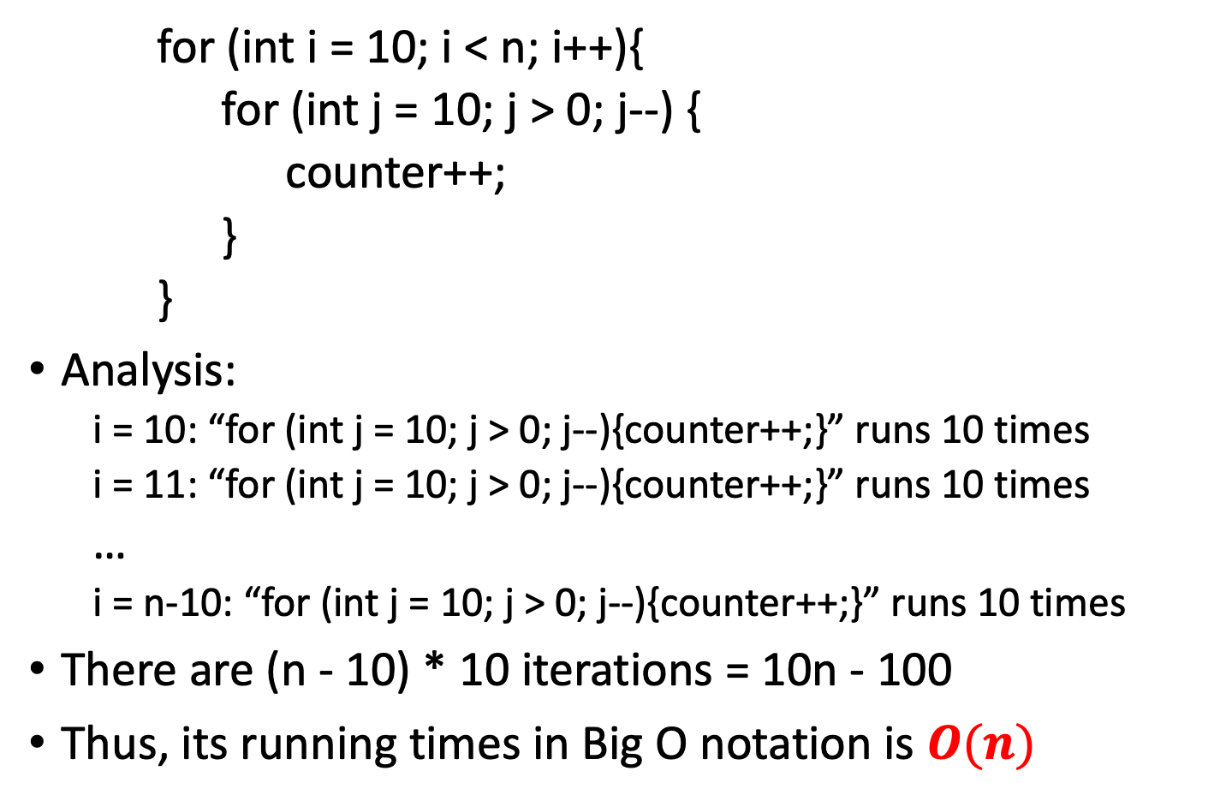
Expressing iterations in terms of n
// Run (n-10) times
for (int i = 10; i < n; i++){
for (int j = 10; j > 0; j--) {
counter++;
}
}
Analysis:
i = 10: “for (int j = 10; j > 0; j--){counter++;}” runs 10 times
i = 11: “for (int j = 10; j > 0; j--){counter++;}” runs 10 times
…
i = n-10: “for (int j = 10; j > 0; j--){counter++;}” runs 10 times
There are (n - 10) * 10 iterations = 10n - 100
Thus, its running times in Big O notation is $O(n)$
// Run 10 times

Slide 25
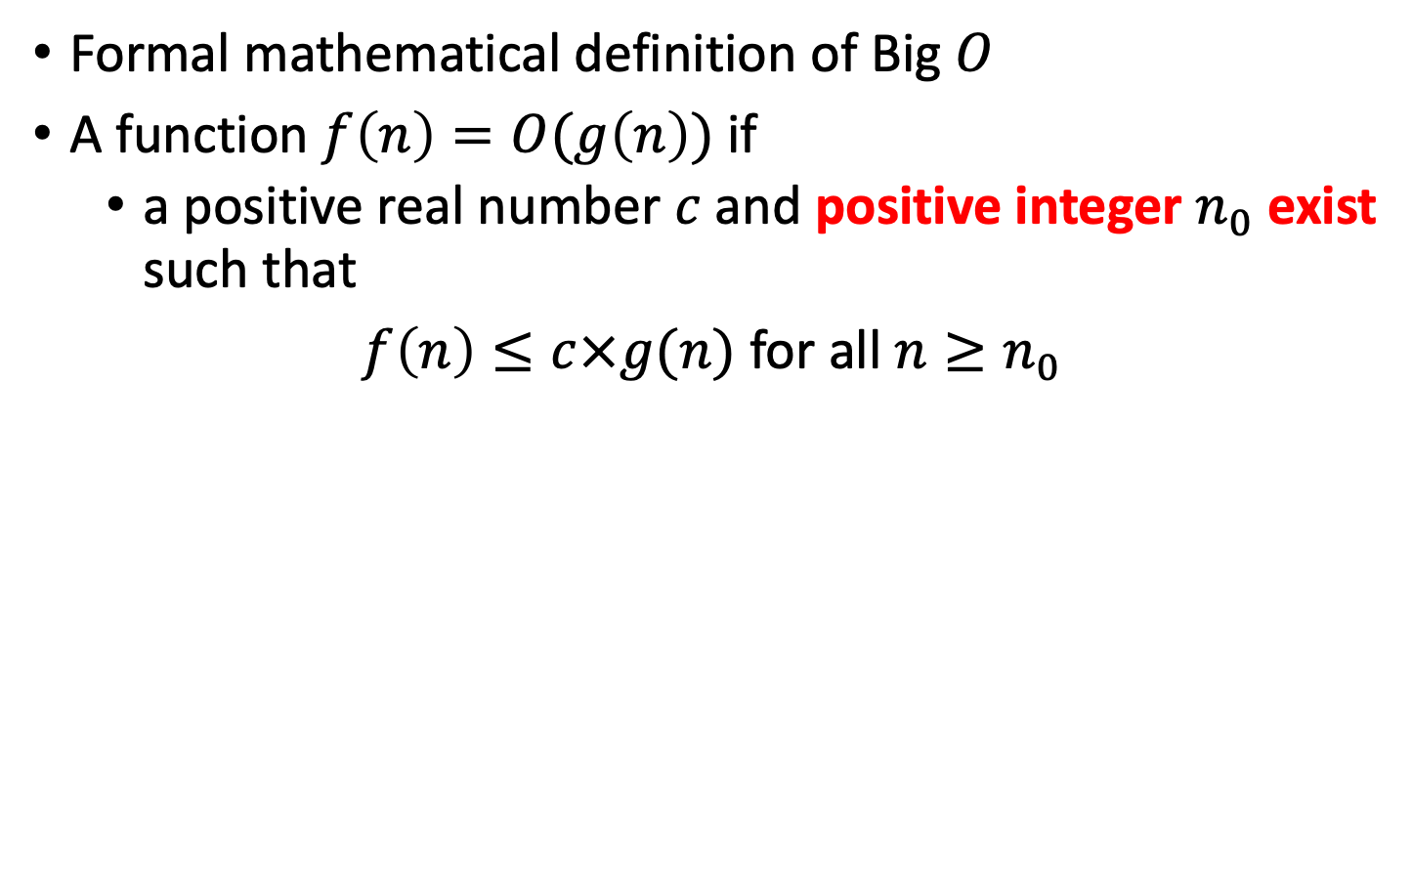
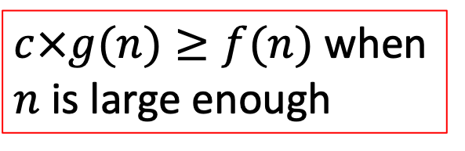
Formalities
Formal mathematical definition of Big $O$
A function $f\left(n\right)=O(g\left(n\right))$if
a positive real number $c$ and positive integer $n_{0}$ exist such that
$f\left(n\right)≤c×g(n)$ for all $n≥n_{0}$
$c×g(n)≥f(n)$ when $n$ is large enough

Slide 26
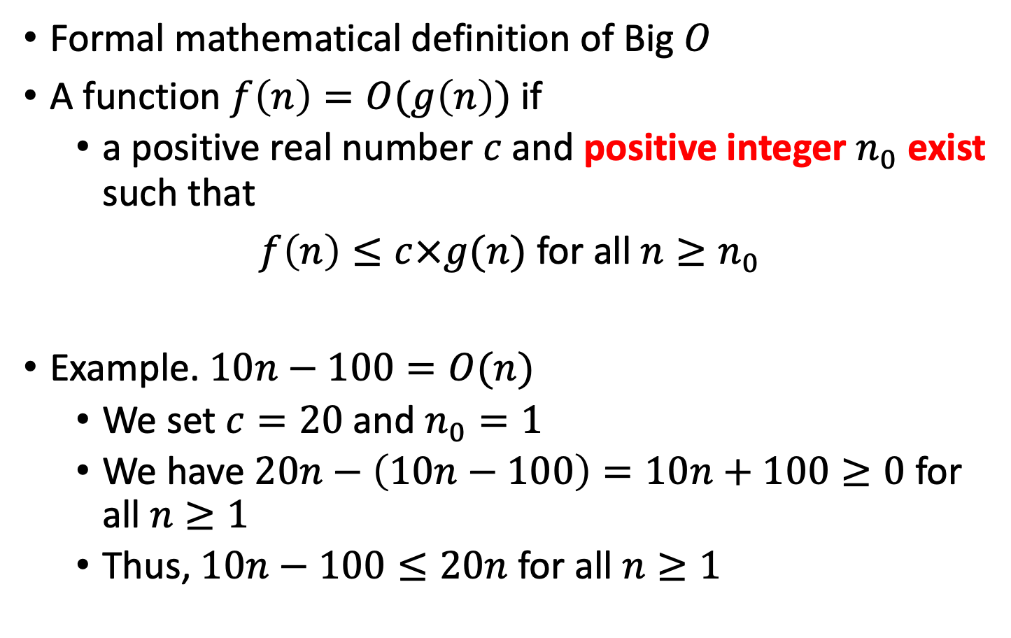
Formalities
Formal mathematical definition of Big $O$
A function $f\left(n\right)=O(g\left(n\right))$if
a positive real number $c$ and positive integer $n_{0}$ exist such that
$f\left(n\right)≤c×g(n)$ for all $n≥n_{0}$
Example. $10n−100=O(n)$
We set $c=20$ and $n_{0}=1$
We have $20n−\left(10n−100\right)=10n+100≥0$ for all $n≥1$
Thus, $10n−100≤20n$ for all $n≥1$

Slide 27
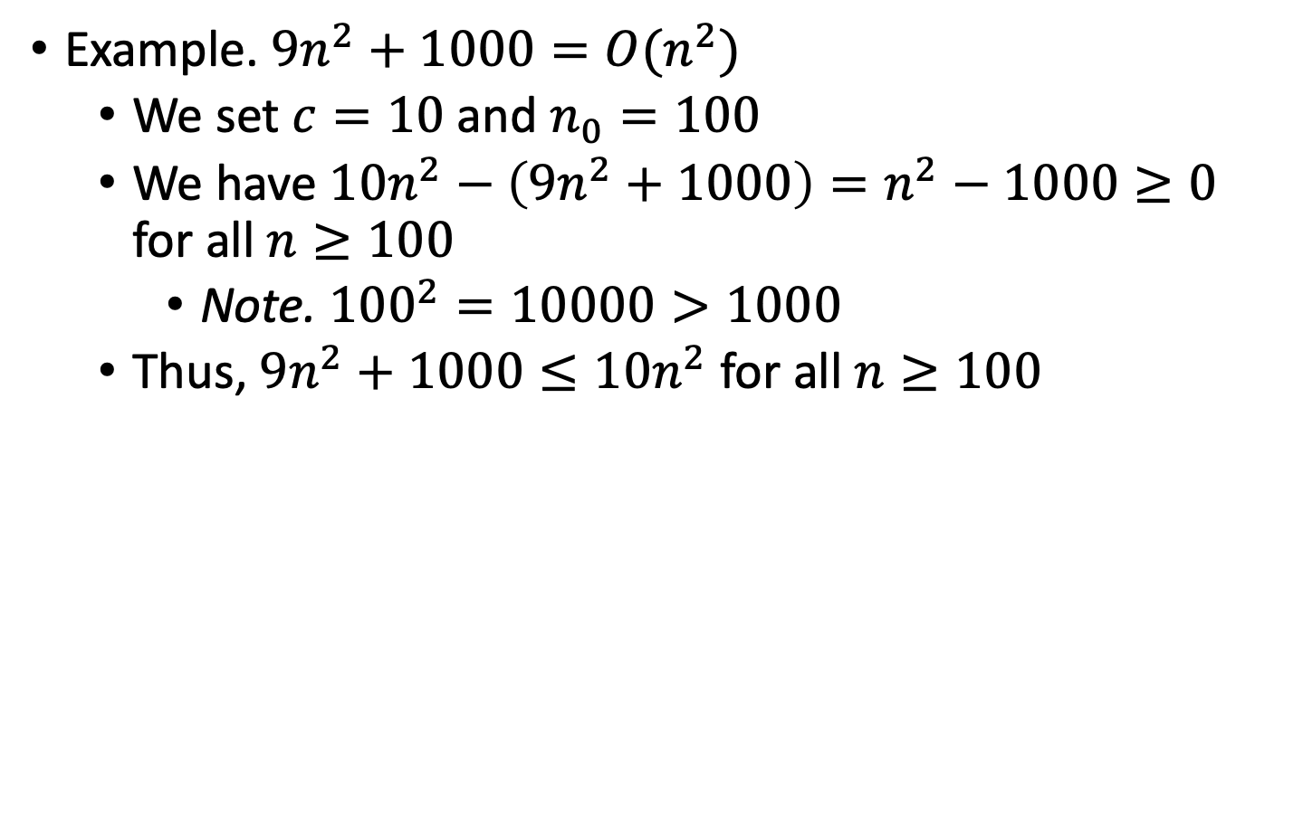
More examples
Example. $9n^{2}+1000=O(n^{2})$
We set $c=10$ and $n_{0}=100$
We have $10n^{2}−\left(9n^{2}+1000\right)=n^{2}−1000≥0$ for all $n≥100$
Note. ${100}^{2}=10000>1000$
Thus, $9n^{2}+1000≤10n^{2}$ for all $n≥100$

Slide 28
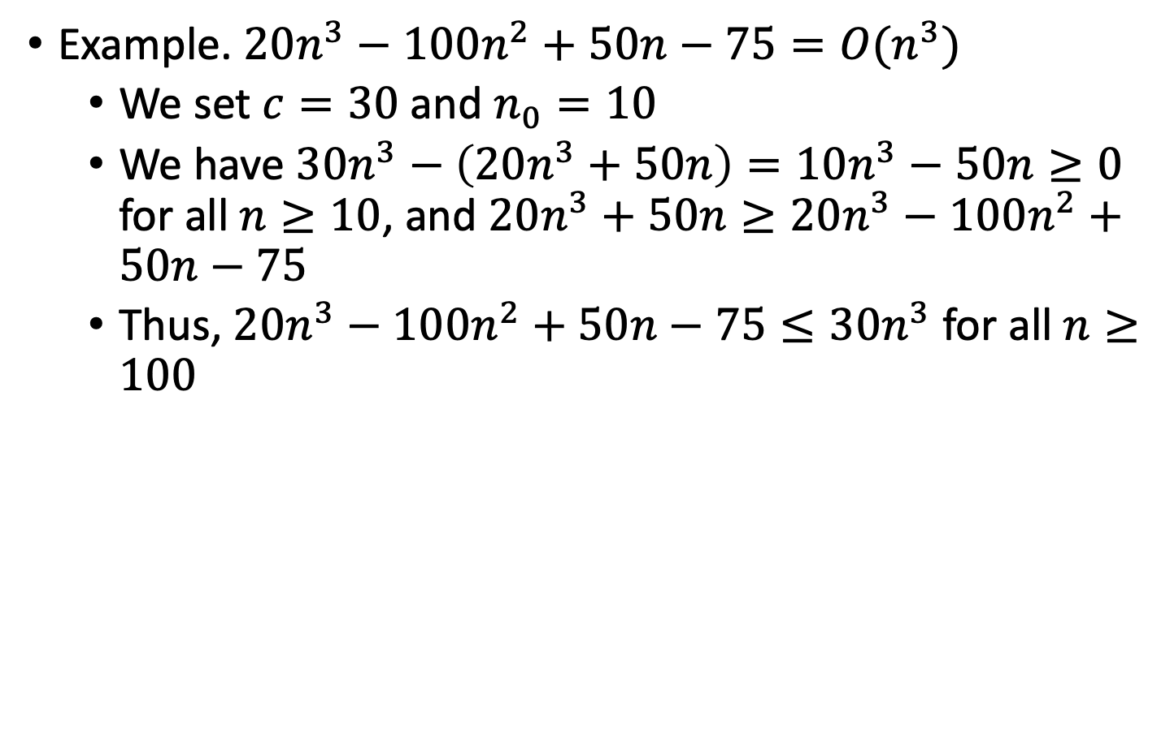
More examples
Example. $20n^{3}−100n^{2}+50n−75=O(n^{3})$
We set $c=30$ and $n_{0}=10$
We have $30n^{3}−\left(20n^{3}+50n\right)=10n^{3}−50n≥0$ for all $n≥10$, and $20n^{3}+50n≥20n^{3}−100n^{2}+50n−75$
Thus, $20n^{3}−100n^{2}+50n−75≤30n^{3}$ for all $n≥100$

Slide 29
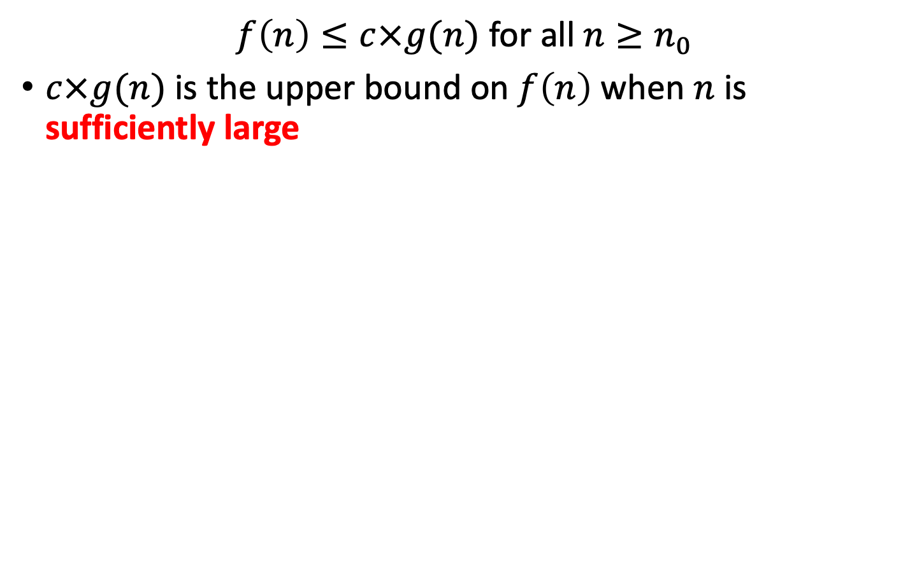
Graph
$f\left(n\right)≤c×g(n)$ for all $n≥n_{0}$
$c×g(n)$ is the upper bound on $f\left(n\right)$ when $n$ is sufficiently large

Slide 30
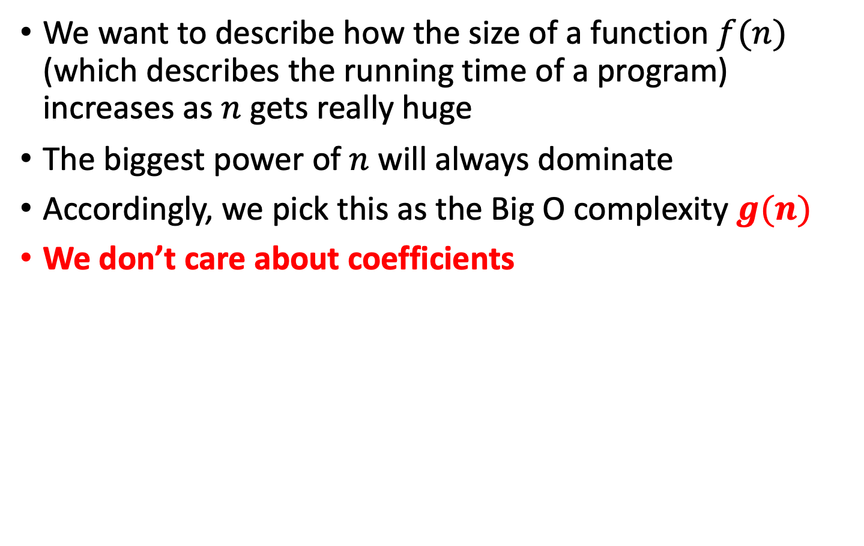
Interpretation
We want to describe how the size of a function $f(n)$ (which describes the running time of a program) increases as $n$ gets really huge
The biggest power of $n$ will always dominate
Accordingly, we pick this as the Big O complexity $g(n)$
We don’t care about coefficients

Slide 31
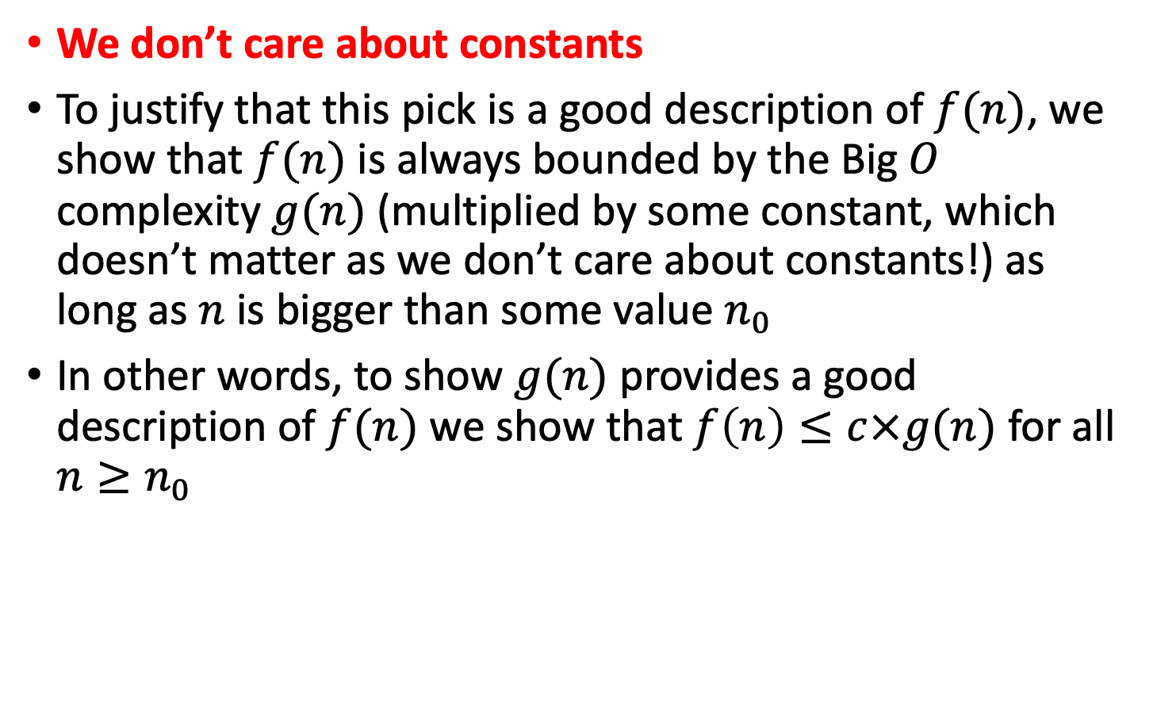
Interpretation
We don’t care about constants
To justify that this pick is a good description of $f(n)$, we show that $f(n)$ is always bounded by the Big $O$ complexity $g(n)$ (multiplied by some constant, which doesn’t matter as we don’t care about constants!) as long as $n$ is bigger than some value $n_{0}$
In other words, to show $g(n)$ provides a good description of $f(n)$ we show that $f\left(n\right)≤c×g(n)$ for all $n≥n_{0}$

Slide 32
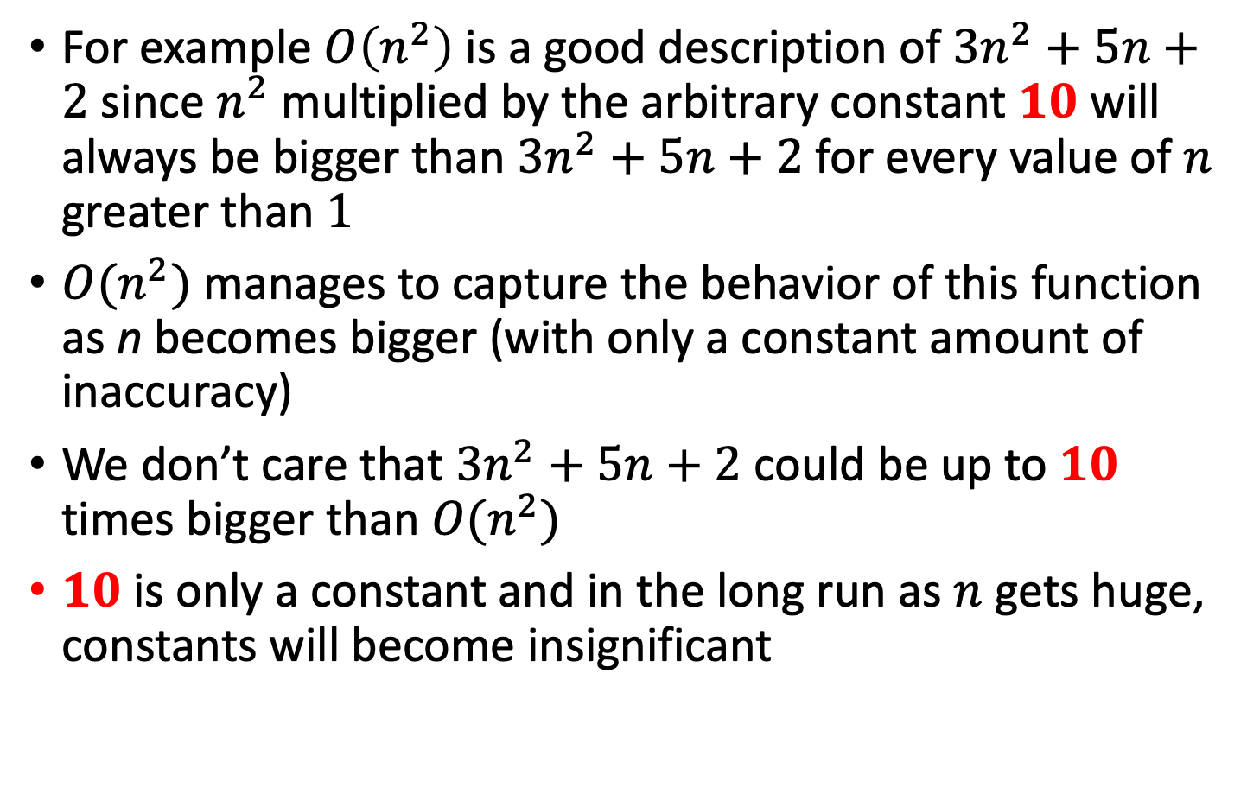
Interpretation
For example $O\left(n^{2}\right)$ is a good description of $3n^{2}+5n+2$ since $n^{2}$ multiplied by the arbitrary constant $10$ will always be bigger than $3n^{2}+5n+2$ for every value of $n$ greater than $1$
$O(n^{2})$ manages to capture the behavior of this function as n becomes bigger (with only a constant amount of inaccuracy)
We don’t care that $3n^{2}+5n+2$ could be up to $10$ times bigger than $O(n^{2})$
$10$ is only a constant and in the long run as $n$ gets huge, constants will become insignificant

Slide 33
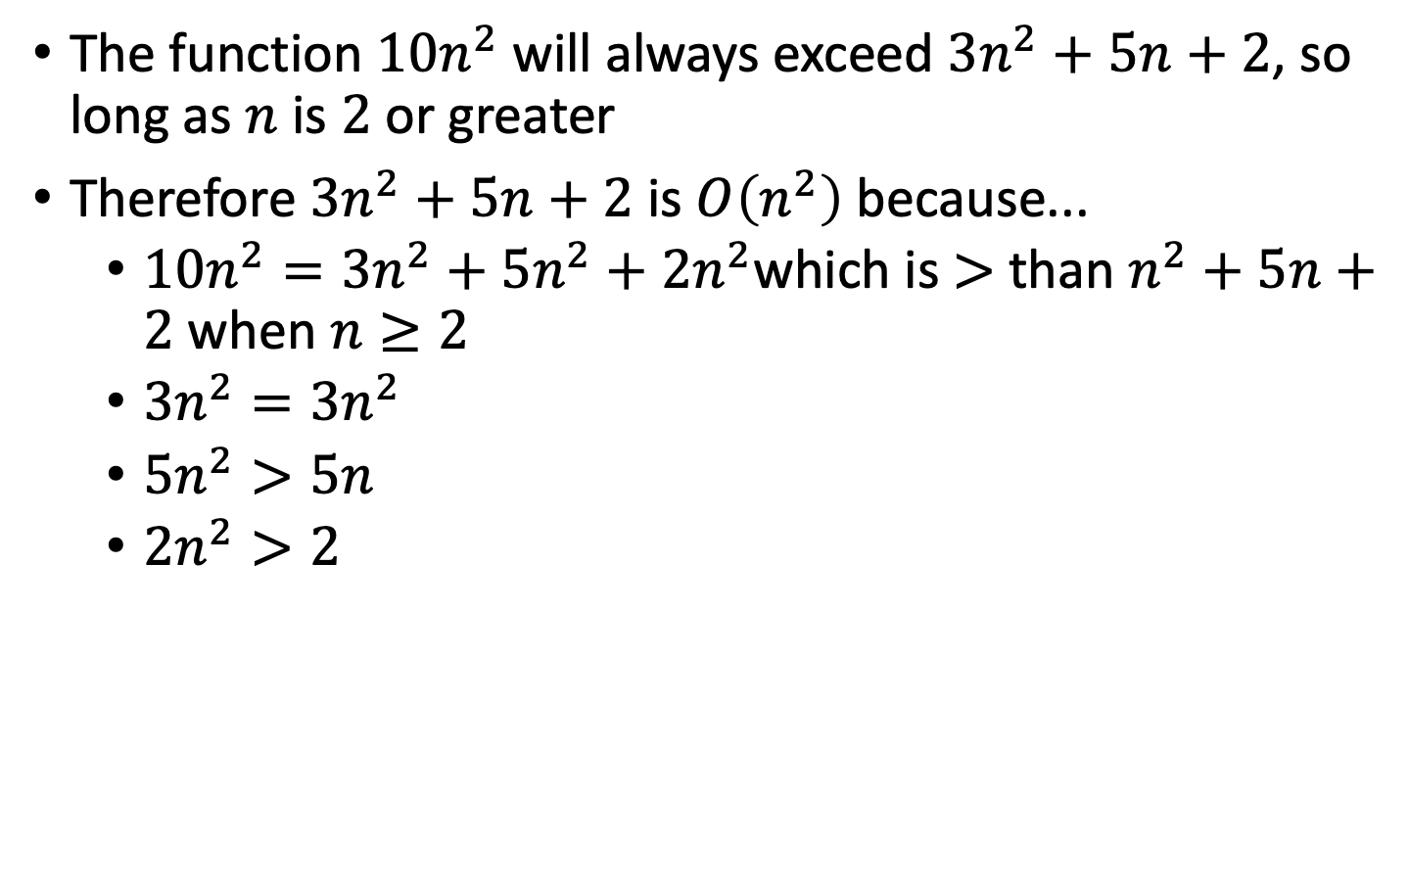
Example
The function $10n^{2}$ will always exceed $3n^{2}+5n+2$, so long as $n$ is $2$ or greater
Therefore $3n^{2}+5n+2$ is $O\left(n^{2}\right)$because...
$10n^{2}=3n^{2}+5n^{2}+2n^{2}$which is $>$ than $n^{2}+5n+2$ when $n≥2$
$3n^{2}=3n^{2}$
$5n^{2}>5n$
$2n^{2}>2$

Slide 34
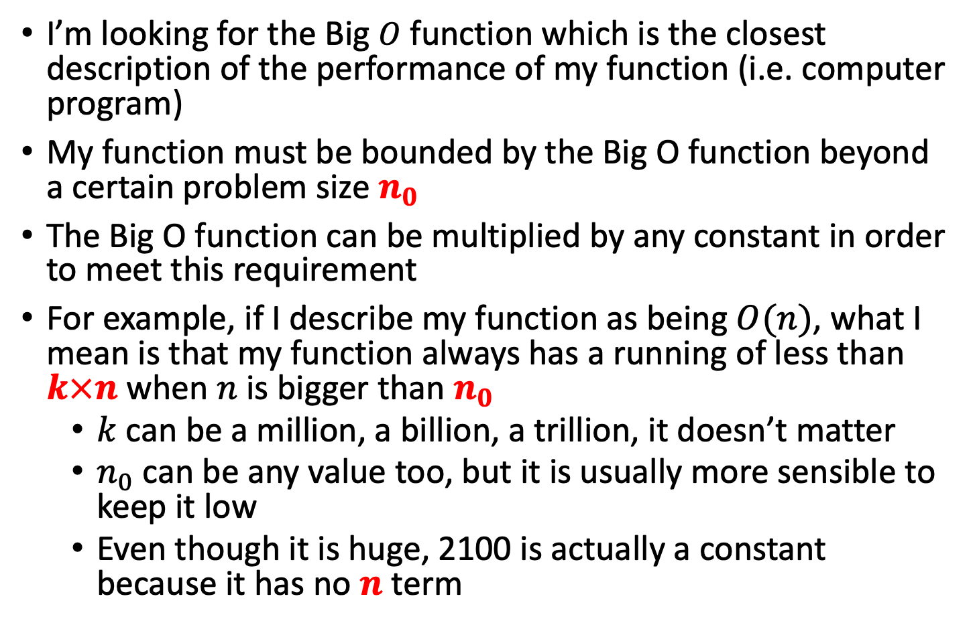
Explain?
I’m looking for the Big $O$ function which is the closest description of the performance of my function (i.e. computer program)
My function must be bounded by the Big O function beyond a certain problem size $n_{0}$
The Big O function can be multiplied by any constant in order to meet this requirement
For example, if I describe my function as being $O(n)$, what I mean is that my function always has a running of less than $k×n$ when $n$ is bigger than $n_{0}$
$k$ can be a million, a billion, a trillion, it doesn’t matter
$n_{0}$ can be any value too, but it is usually more sensible to keep it low
Even though it is huge, 2100 is actually a constant because it has no $n$ term

Slide 35
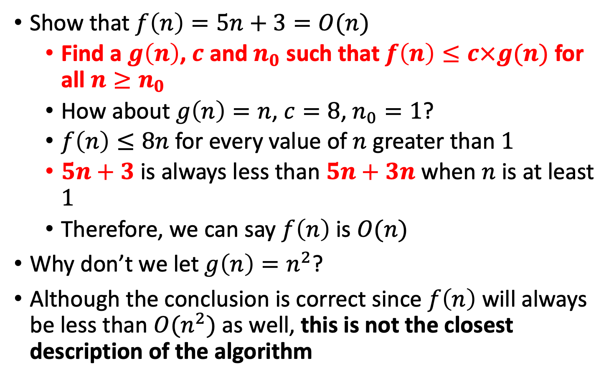
Example
Show that $f\left(n\right)=5n+3=O(n)$
Find a $g\left(n\right)$, $c$ and $n_{0}$ such that $f\left(n\right)≤c×g(n)$ for all $n≥n_{0}$
How about $g\left(n\right)=n$, $c=8$, $n_{0}=1$?
$f\left(n\right)≤8n$ for every value of $n$ greater than $1$
$5n+3$ is always less than $5n+3n$ when $n$ is at least $1$
Therefore, we can say $f\left(n\right)$ is $O(n)$
Why don’t we let $g\left(n\right)=n^{2}$?
Although the conclusion is correct since $f\left(n\right)$ will always be less than $O(n^{2})$ as well, this is not the closest description of the algorithm

Slide 36
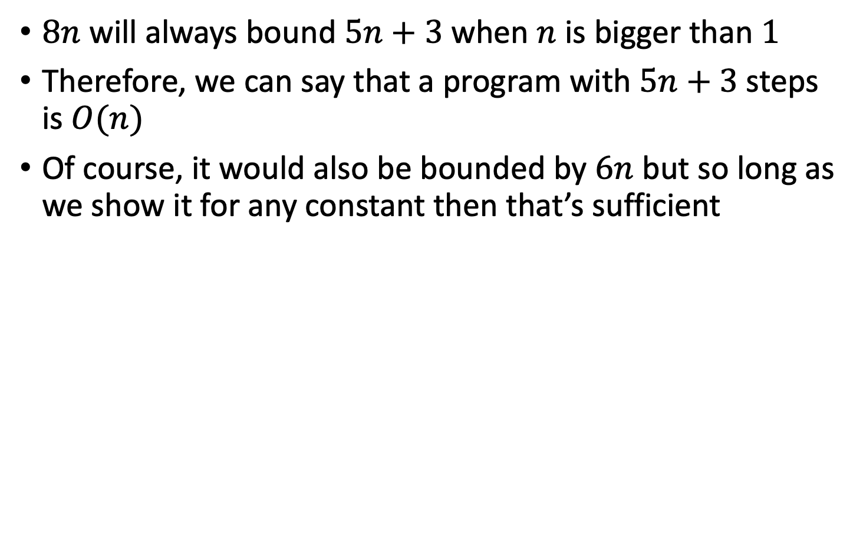
Example
$8n$ will always bound $5n+3$when $n$ is bigger than $1$
Therefore, we can say that a program with $5n+3$steps is $O(n)$
Of course, it would also be bounded by $6n$ but so long as we show it for any constant then that’s sufficient

Slide 37
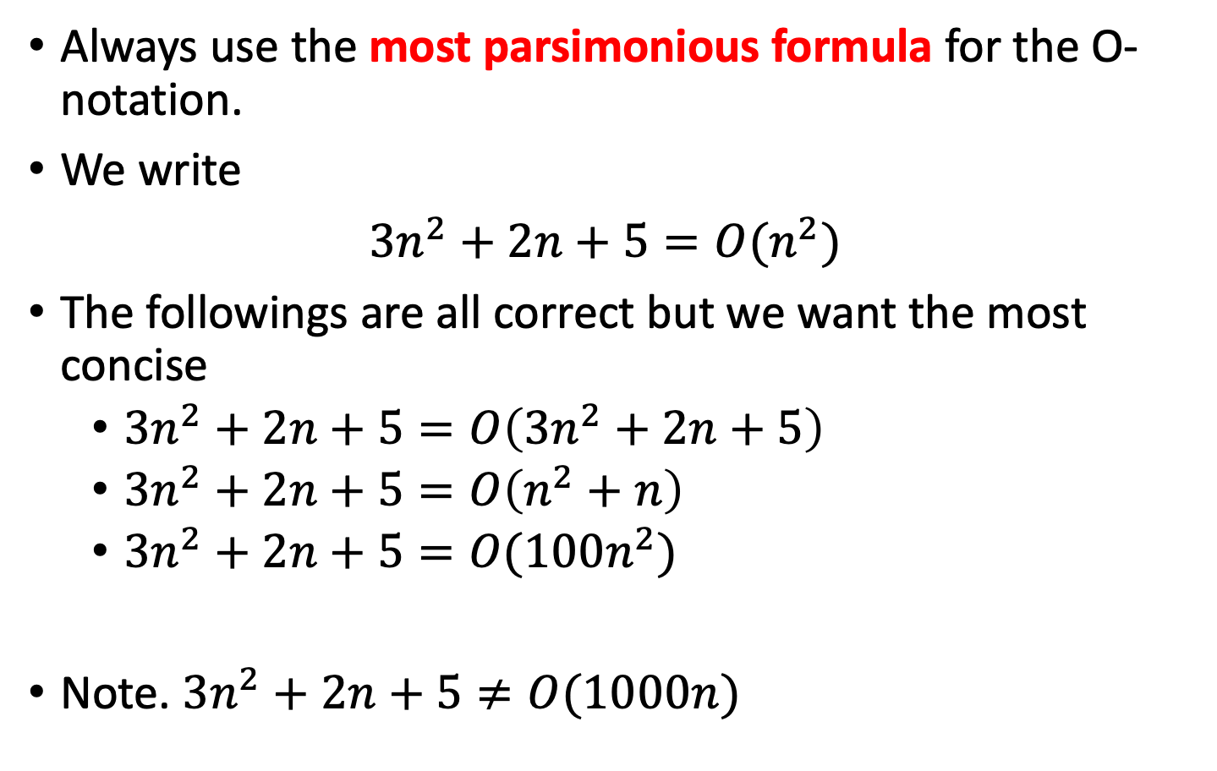
Usage
Always use the most parsimonious formula for the O-notation.
We write
$3n^{2}+2n+5=O(n^{2})$
The followings are all correct but we want the most concise
$3n^{2}+2n+5=O\left(3n^{2}+2n+5\right)$
$3n^{2}+2n+5=O\left(n^{2}+n\right)$
$3n^{2}+2n+5=O(100n^{2})$
Note. $3n^{2}+2n+5≠O(1000n)$

Slide 38
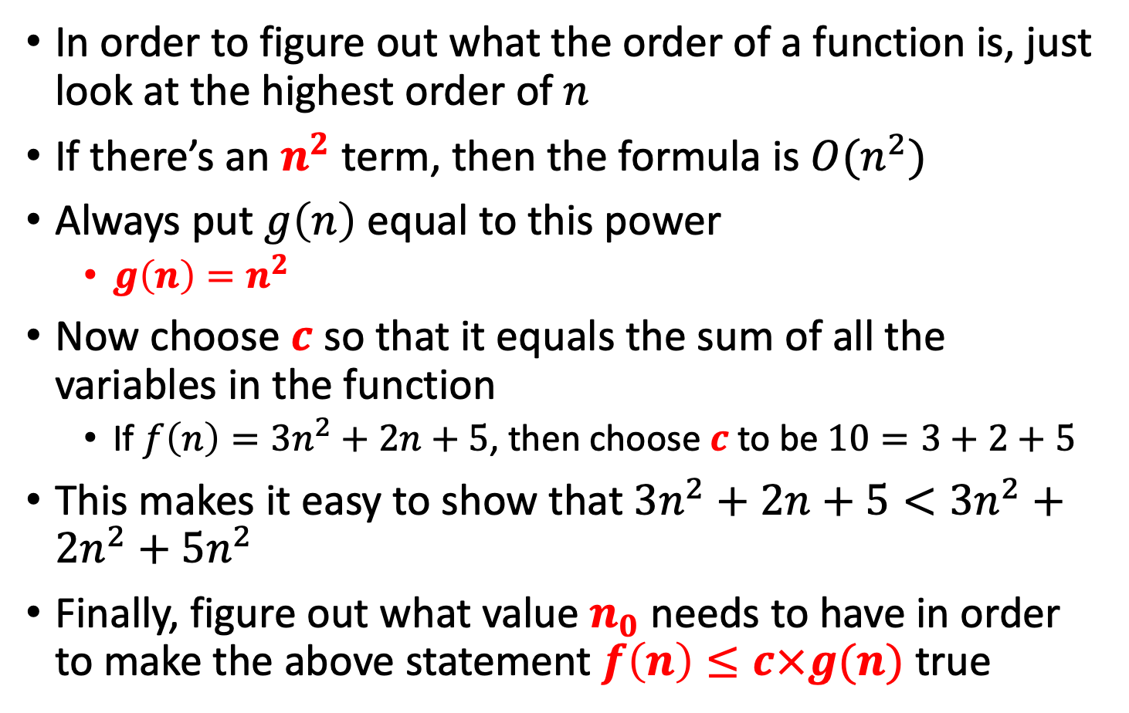
Tip
In order to figure out what the order of a function is, just look at the highest order of $n$
If there’s an $n^{2}$ term, then the formula is $O(n^{2})$
Always put $g\left(n\right)$ equal to this power
$g\left(n\right)=n^{2}$
Now choose $c$ so that it equals the sum of all the variables in the function
If $f\left(n\right)=3n^{2}+2n+5$, then choose $c$ to be $10=3+2+5$
This makes it easy to show that $3n^{2}+2n+5<3n^{2}+2n^{2}+5n^{2}$
Finally, figure out what value $n_{0}$ needs to have in order to make the above statement $f\left(n\right)≤c×g(n)$ true

Slide 39
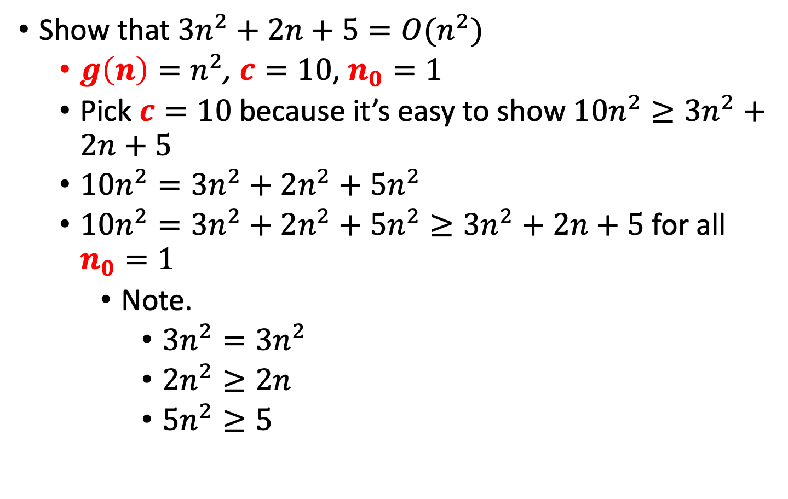
Example of O-notation
Show that $3n^{2}+2n+5=O(n^{2})$
$g\left(n\right)=n^{2}$, $c=10$, $n_{0}=1$
Pick $c=10$because it’s easy to show $10n^{2}≥3n^{2}+2n+5$
$10n^{2}=3n^{2}+2n^{2}+5n^{2}$
$10n^{2}=3n^{2}+2n^{2}+5n^{2}≥3n^{2}+2n+5$ for all $n_{0}=1$
Note.
$3n^{2}=3n^{2}$
$2n^{2}≥2n$
$5n^{2}≥5$

Slide 40
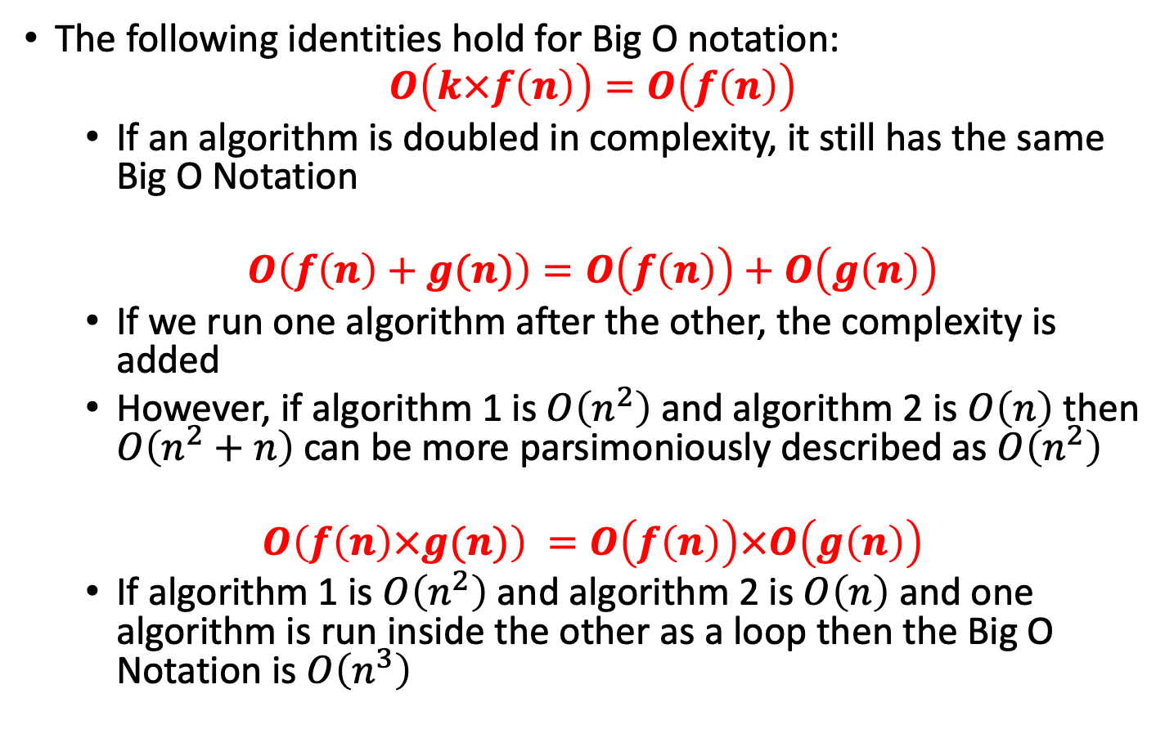
Formalities
The following identities hold for Big O notation:
$$O\left(k×f\left(n\right)\right)=O\left(f\left(n\right)\right)$$
If an algorithm is doubled in complexity, it still has the same Big O Notation
$$O\left(f\left(n\right)+g(n)\right)=O\left(f\left(n\right)\right)+O\left(g\left(n\right)\right)$$
If we run one algorithm after the other, the complexity is added
However, if algorithm 1 is $O\left(n^{2}\right)$and algorithm 2 is $O\left(n\right)$ then $O\left(n^{2}+n\right)$can be more parsimoniously described as $O\left(n^{2}\right)$
$$O\left(f\left(n\right)×g(n)\right) =O\left(f\left(n\right)\right)×O\left(g\left(n\right)\right)$$
If algorithm 1 is $O\left(n^{2}\right)$and algorithm 2 is $O\left(n\right)$ and one algorithm is run inside the other as a loop then the Big O Notation is $O\left(n^{3}\right)$

Slide 41
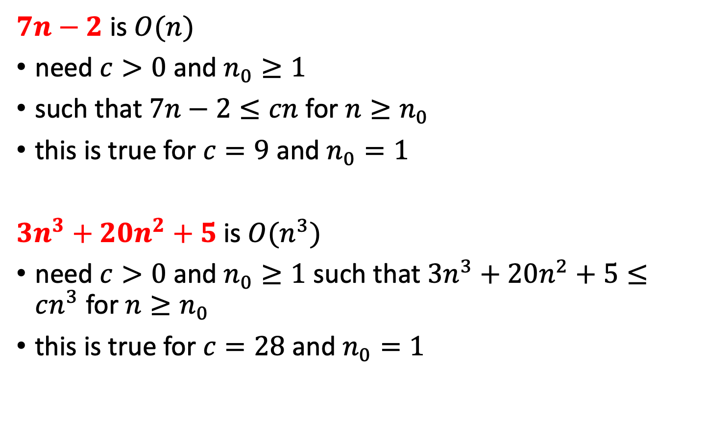
Big-O Examples
$7n−2$ is $O(n)$
need $c>0$ and $n_{0}≥1$
such that $7n−2≤cn$ for $n≥n_{0}$
this is true for $c=9$ and $n_{0}=1$
$3n^{3}+20n^{2}+5$is $O(n^{3})$
need $c>0$ and $n_{0}≥1$ such that $3n^{3}+20n^{2}+5≤cn^{3}$ for $n≥n_{0}$
this is true for $c=28$ and $n_{0}=1$

Slide 42
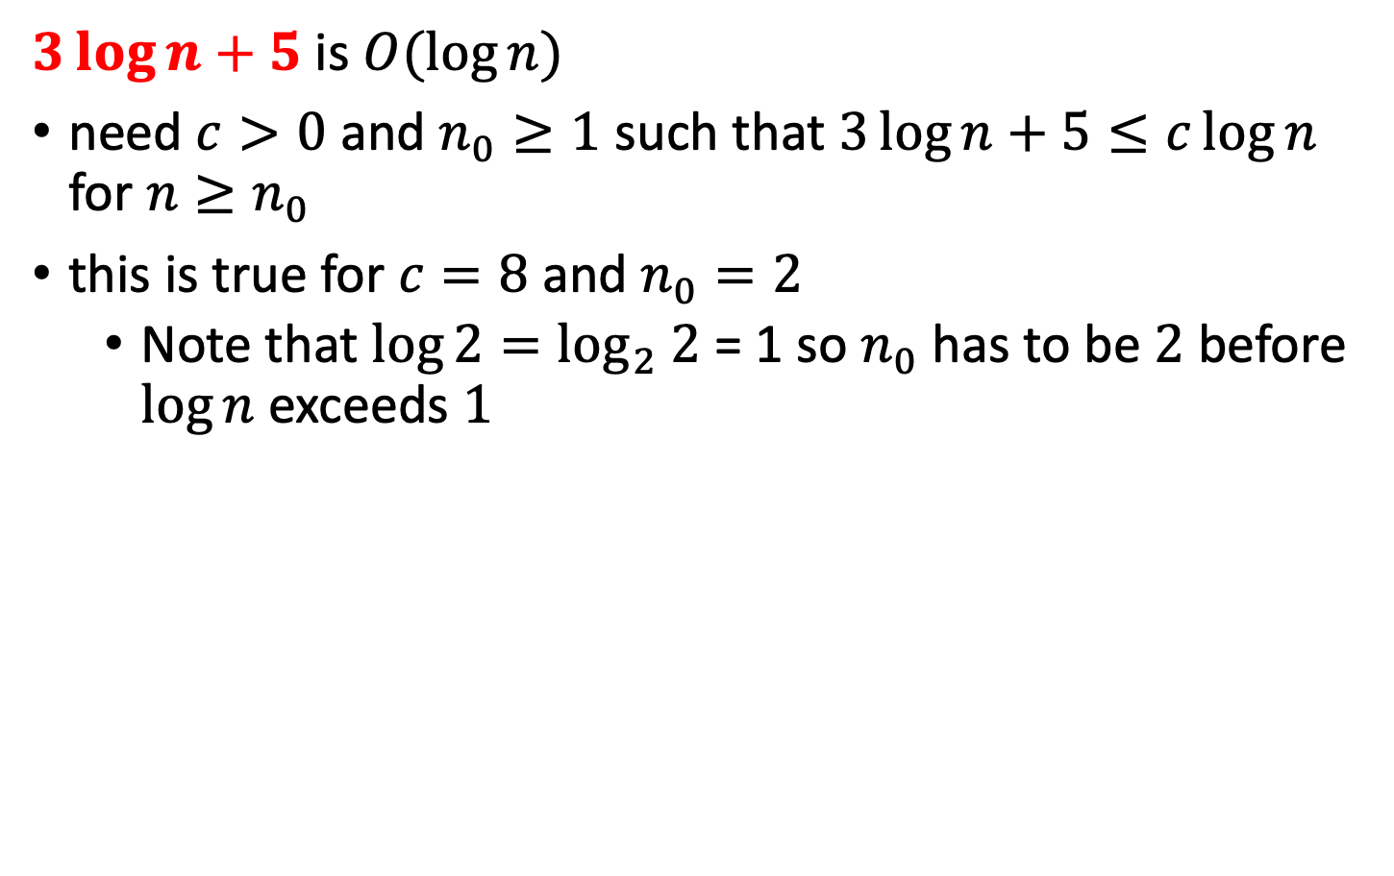
Big-O Examples
$3\log{n}+5$ is $O(\log{n})$
need $c>0$ and $n_{0}≥1$ such that $3\log{n}+5≤c\log{n}$ for $n≥n_{0}$
this is true for $c=8$ and $n_{0}=2$
Note that $\log{2}=\log_{2} 2$ = 1 so $n_{0}$ has to be $2$ before $\log{n}$ exceeds $1$

Slide 43
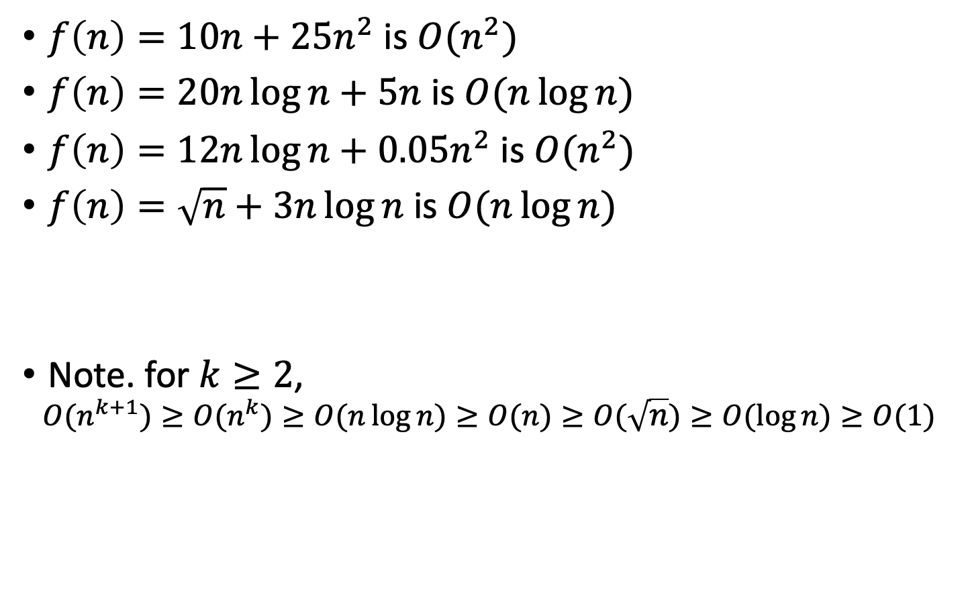
Keeping it simple
$f\left(n\right)=10n+25n^{2}$ is $O(n^{2})$
$f\left(n\right)=20n\log{n}+5n$ is $O(n\log{n})$
$f\left(n\right)=12n\log{n}+0.05n^{2}$ is $O(n^{2})$
$f\left(n\right)=\sqrt{n}+3n\log{n}$ is $O(n\log{n})$
Note. for $k≥2$,
$$O(n^{k+1})≥O(n^{k})≥O(n\log{n})≥O(n)≥O(\sqrt{n})≥O(\log{n})≥O(1)$$

Slide 44
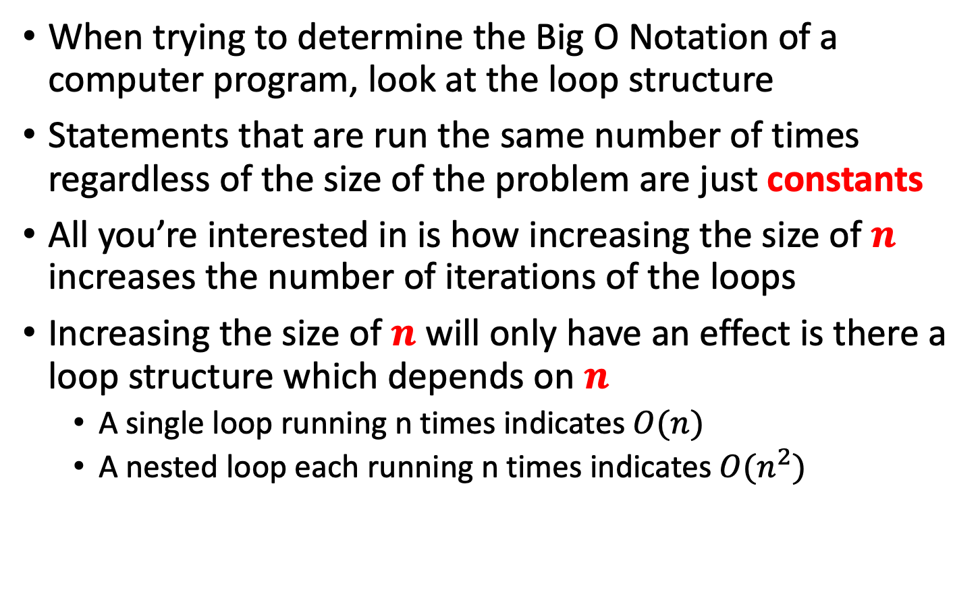
Getting Big O of a program
When trying to determine the Big O Notation of a computer program, look at the loop structure
Statements that are run the same number of times regardless of the size of the problem are just constants
All you’re interested in is how increasing the size of $n$ increases the number of iterations of the loops
Increasing the size of $n$ will only have an effect is there a loop structure which depends on $n$
A single loop running n times indicates $O(n)$
A nested loop each running n times indicates $O(n^{2})$

Slide 45
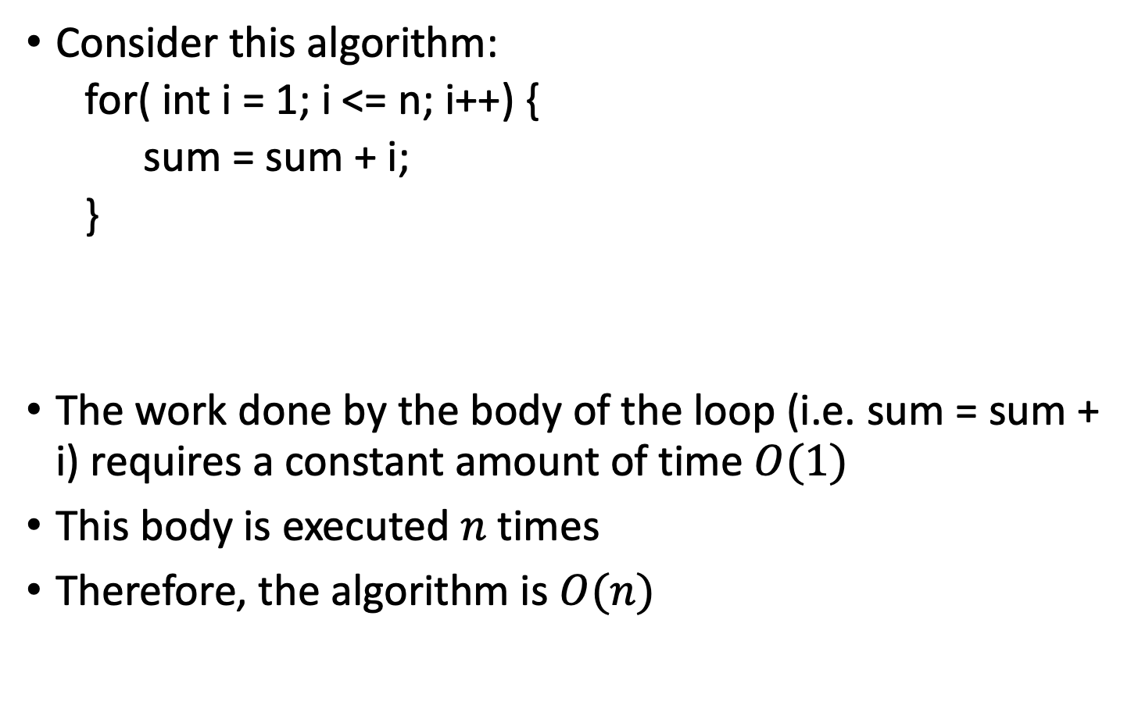
Picturing Efficiency
Consider this algorithm:
for( int i = 1; i <= n; i++) {
sum = sum + i;
}
The work done by the body of the loop (i.e. sum = sum + i) requires a constant amount of time $O(1)$
This body is executed $n$ times
Therefore, the algorithm is $O(n)$

Slide 46
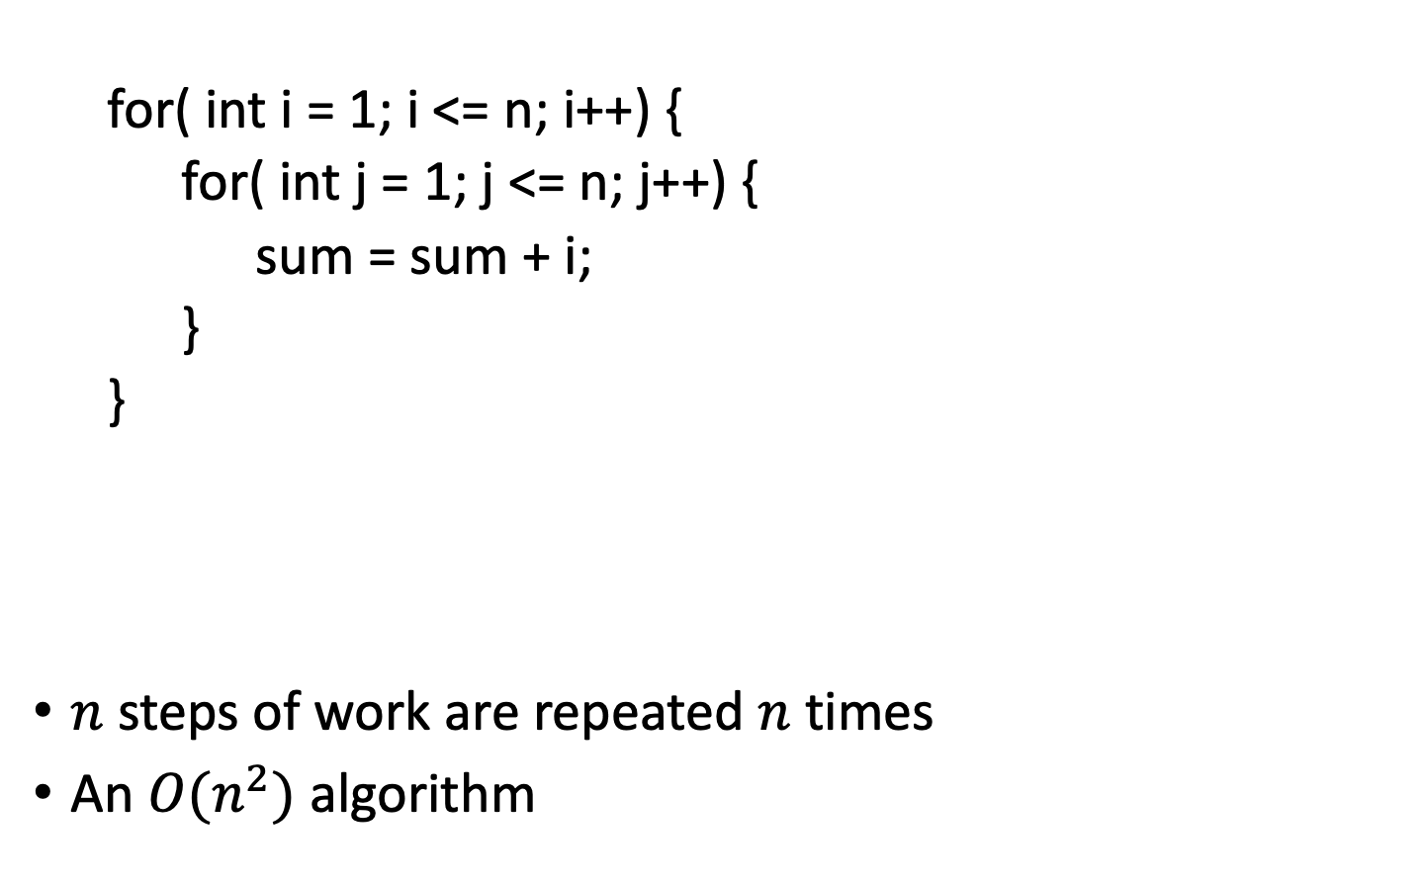
Picturing Efficiency
for( int i = 1; i <= n; i++) {
for( int j = 1; j <= n; j++) {
sum = sum + i;
}
}
$n$ steps of work are repeated $n$ times
An $O(n^{2})$ algorithm

Slide 47
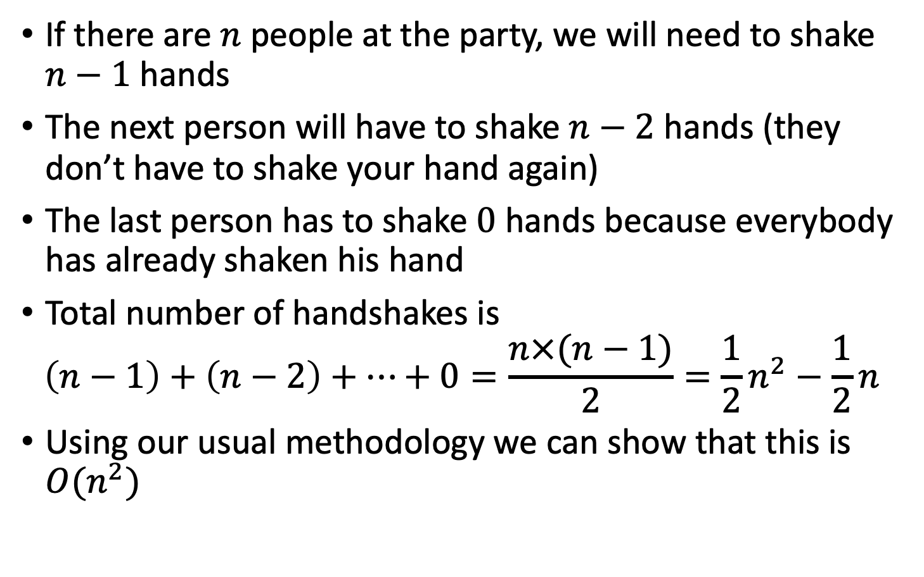
Shaking hands at a party
If there are $n$ people at the party, we will need to shake $n−1$ hands
The next person will have to shake $n−2$ hands (they don’t have to shake your hand again)
The last person has to shake $0$ hands because everybody has already shaken his hand
Total number of handshakes is
$$\left(n−1\right)+\left(n−2\right)+…+0=\frac{n×(n−1)}{2}=\frac{1}{2}n^{2}−\frac{1}{2}n$$
Using our usual methodology we can show that this is $O(n^{2})$

Slide 48
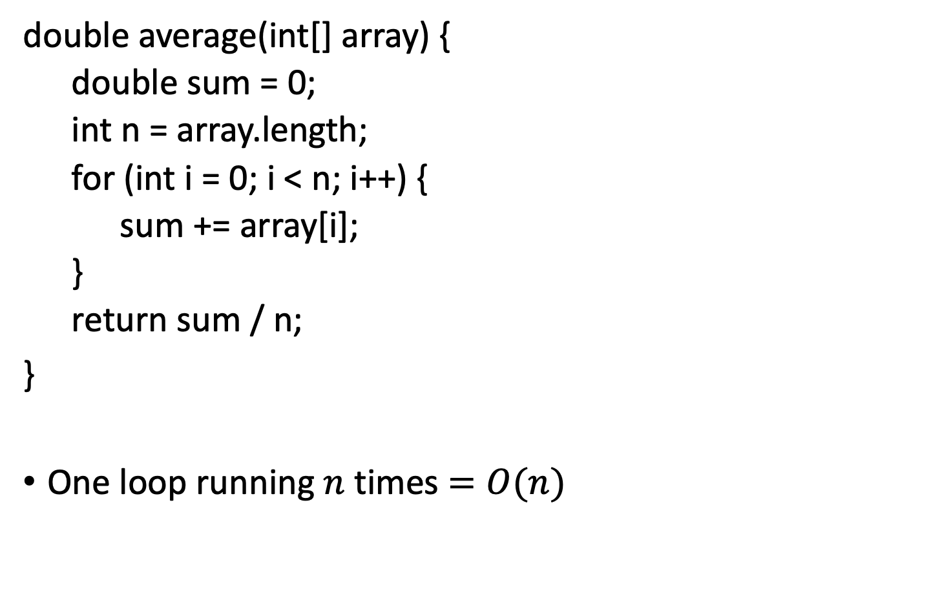
Compute average of array
double average(int[] array) {
double sum = 0;
int n = array.length;
for (int i = 0; i < n; i++) {
sum += array[i];
}
return sum / n;
}
One loop running $n$ times $=O(n)$

Slide 49
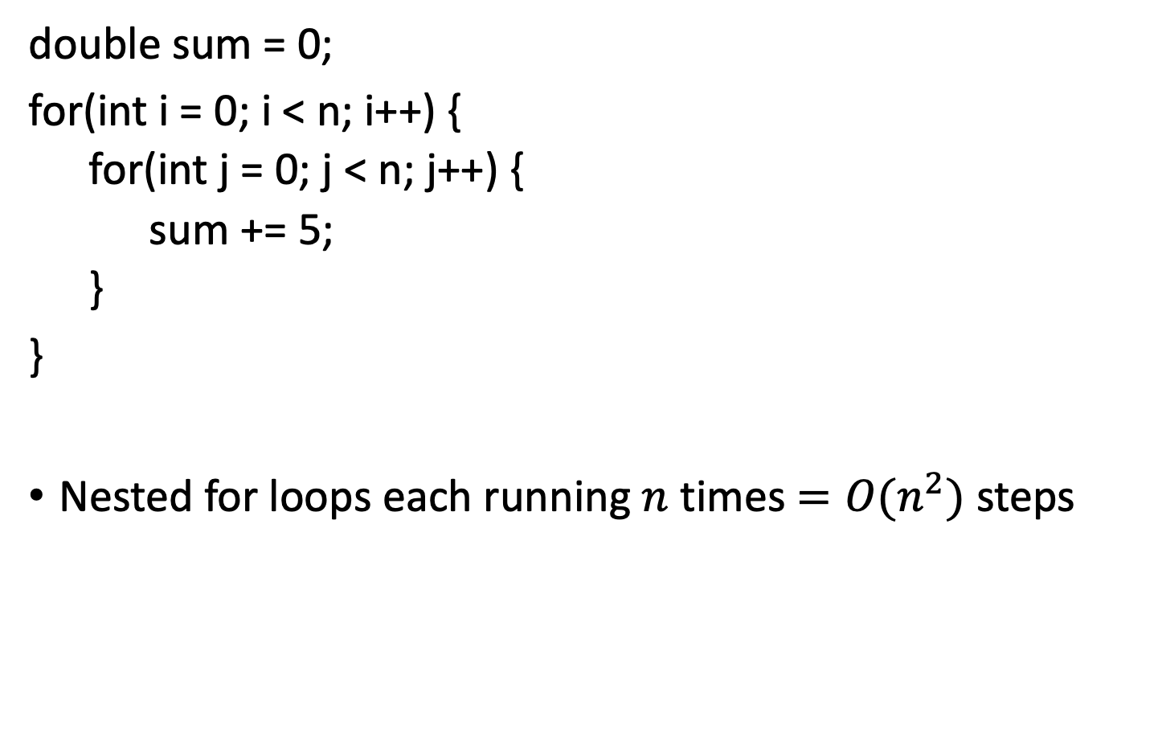
Nested Loops
double sum = 0;
for(int i = 0; i < n; i++) {
for(int j = 0; j < n; j++) {
sum += 5;
}
}
Nested for loops each running $n$ times $=O(n^{2})$steps

Slide 50
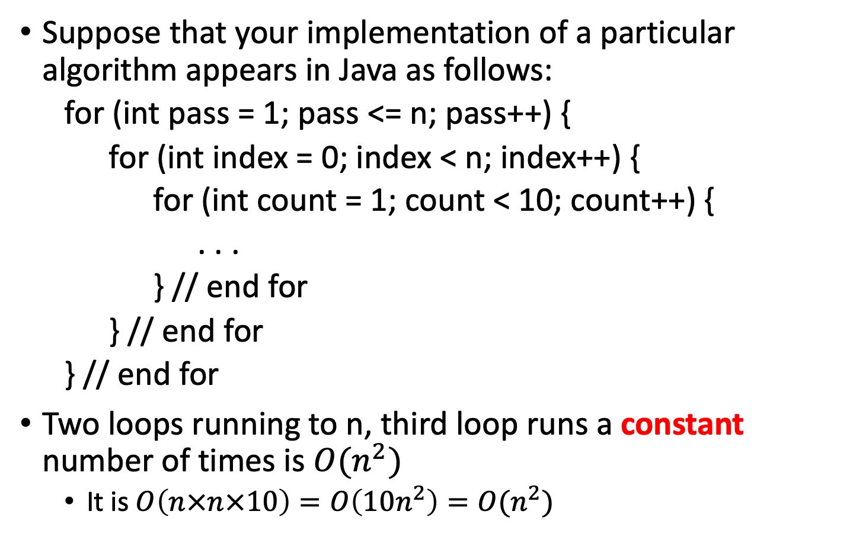
Loop running constant number of times
Suppose that your implementation of a particular algorithm appears in Java as follows:
for (int pass = 1; pass <= n; pass++) {
for (int index = 0; index < n; index++) {
for (int count = 1; count < 10; count++) {
. . .
} // end for
} // end for
} // end for
Two loops running to n, third loop runs a constant number of times is $O(n^{2})$
It is $O\left(n×n×10\right)=O\left(10n^{2}\right)=O(n^{2})$

Slide 51
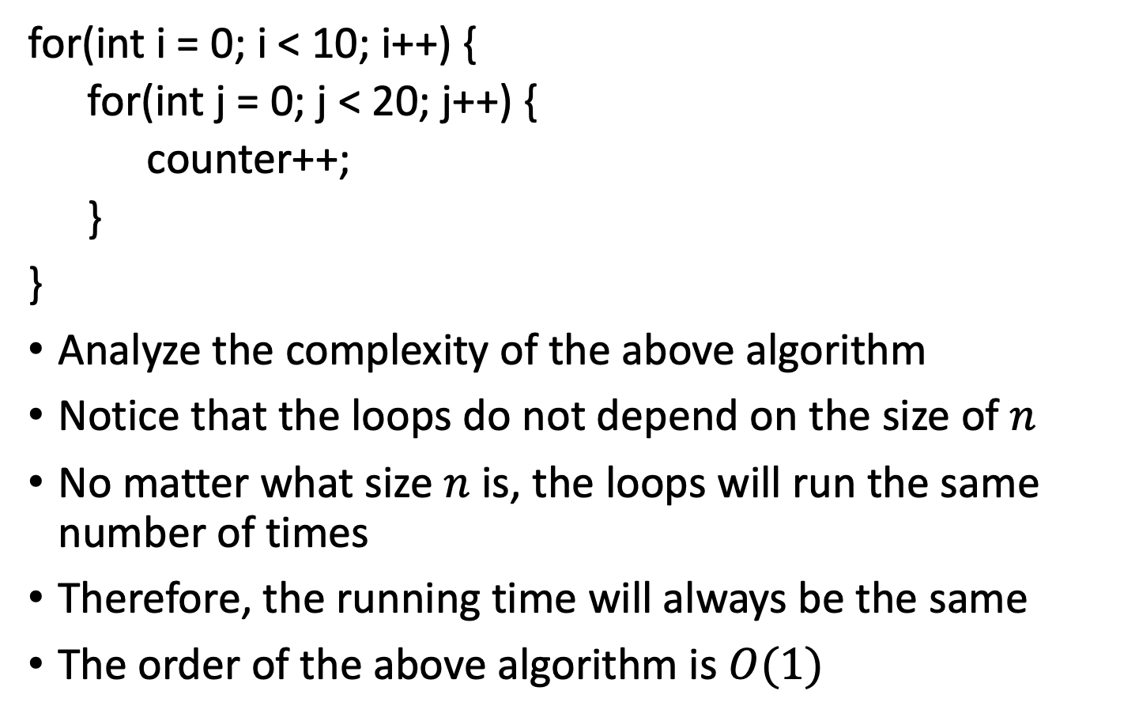
How about this loop?
for(int i = 0; i < 10; i++) {
for(int j = 0; j < 20; j++) {
counter++;
}
}
Analyze the complexity of the above algorithm
Notice that the loops do not depend on the size of $n$
No matter what size $n$ is, the loops will run the same number of times
Therefore, the running time will always be the same
The order of the above algorithm is $O(1)$

Slide 52
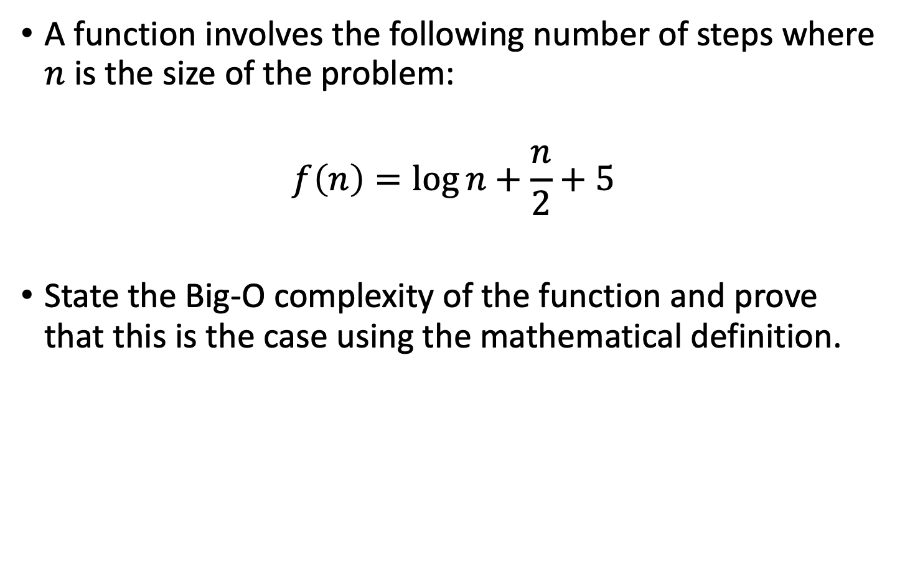
Exam Question
A function involves the following number of steps where $n$ is the size of the problem:
$$f\left(n\right)=\log{n}+\frac{n}{2}+5$$
State the Big-O complexity of the function and prove that this is the case using the mathematical definition.

Slide 53
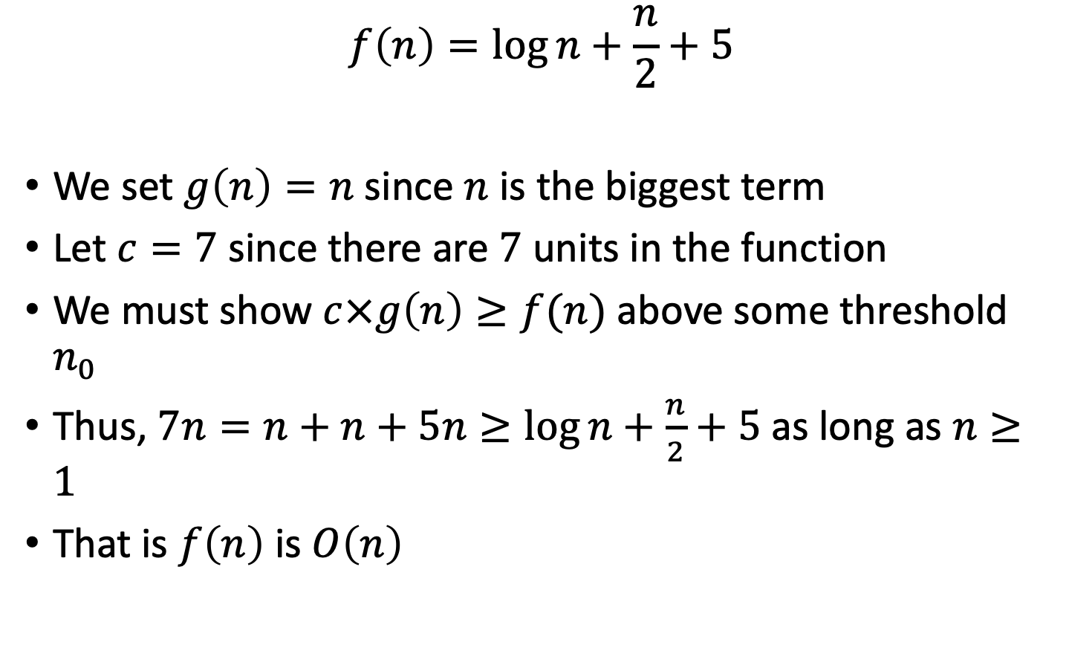
Exam Question
$$f\left(n\right)=\log{n}+\frac{n}{2}+5$$
We set $g\left(n\right)=n$ since $n$ is the biggest term
Let $c=7$ since there are $7$ units in the function
We must show $c×g\left(n\right)≥f(n)$ above some threshold $n_{0}$
Thus, $7n=n+n+5n≥\log{n}+\frac{n}{2}+5$ as long as $n≥1$
That is $f\left(n\right)$ is $O\left(n\right)$

Slide 54
Timing Programs
You can check how long your program has been running
There is a System method that allows us to store the current value of the system clock
By comparing two different system clock values we can figure out how long the program has been running
long start = System.currentTimeMillis();
long elapsed = System.currentTimeMillis() - start;

Slide 55
Extended Example 1
Lets consider the time complexity of the following for loop.
for (int i = 1; i <= n; i = 2*i){ count++; }

Slide 56
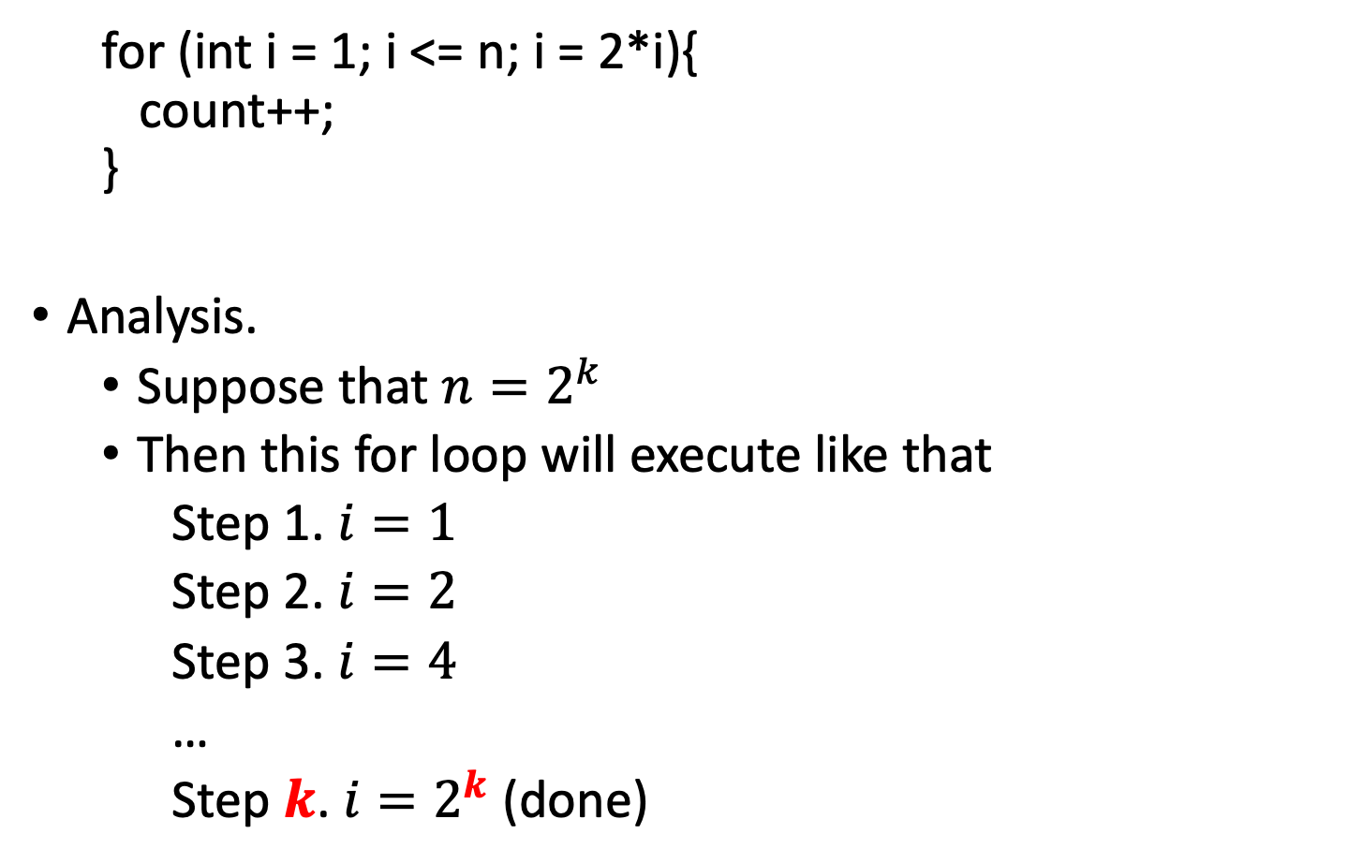
Extended Example 1
for (int i = 1; i <= n; i = 2*i){ count++; }
Analysis.
Suppose that $n=2^{k}$
Then this for loop will execute like that
Step 1. $i=1$
Step 2. $i=2$
Step 3. $i=4$
…
Step $k$. $i=2^{k}$ (done)

Slide 57
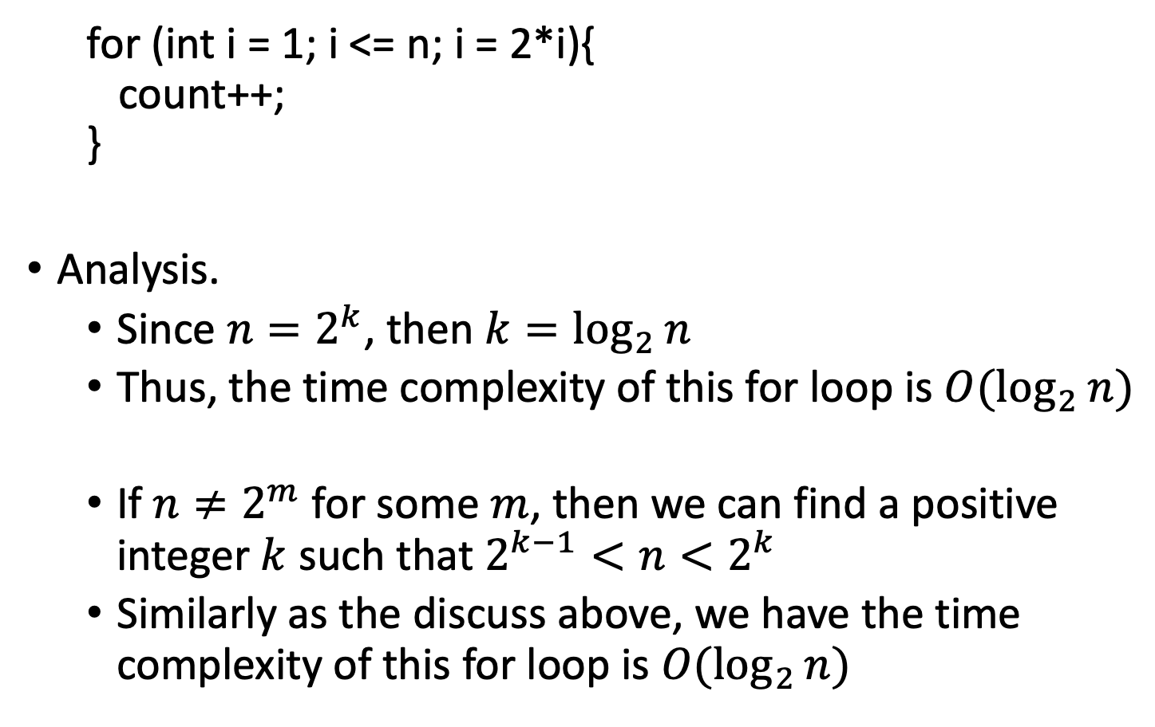
Extended Example 1
for (int i = 1; i <= n; i = 2*i){ count++; }
Analysis.
Since $n=2^{k}$, then $k=\log_{2}{n}$
Thus, the time complexity of this for loop is $O(\log_{2}{n})$
If $n≠2^{m}$ for some $m$, then we can find a positive integer $k$ such that $2^{k−1}<n<2^{k}$
Similarly as the discuss above, we have the time complexity of this for loop is $O(\log_{2}{n})$

Slide 58
Extended Example 2
Lets consider the time complexity of the following for loop.
for (int i = 1; i <= n; i = 3*i){ count++; }
It is your exercise.

Slide 59

Extended Example 3
for (int i = 1; i*i <= n; i = i++){ count++; }
Analysis.
Suppose that $n=k^{2}$ for some positive integer $k$
Then this for loop will execute like that
Step 1. $i=1$ and $1^{2}≤k^{2}=n$
Step 2. $i=2$ and $2^{2}≤k^{2}=n$
Step 3. $i=3$ and $3^{2}≤k^{2}=n$
…
Step $k$. $i=k$ and $k^{2}=n$ (done)

Slide 60

Extended Example 3
for (int i = 1; i*i <= n; i = i++){ count++; }
Analysis.
Since $n=k^{2}$, then $k=\sqrt{n}$
Thus, the time complexity of this for loop is $O(\sqrt{n})$

Slide 61

Extended Example 3
Lets consider the time complexity of the following for loop.
for (int i = 1; i*i <= n; i = i++){ count++; }
It is easy to see that this loop runs as long as $i^{2}≤n$.
This means that the loop will stop at $i>\sqrt{n}$.
And $i$ is growing linearly.
i = i++
Thus, the time complexity of this for loop is $O(\sqrt{n})$

Slide 62
Extended Example 4
Lets consider the time complexity of the following for loop.
for(int i = 0; i < n; i++) {
for(int j = 0; j < i*n; j++)
count++;
}
}

Slide 63

Extended Example 4
for(int i = 0; i < n; i++) {
for(int j = 0; j < i*n; j++)
count++;
}
}
The executed times of the inner loop is
$0+n+2n+3n+…+\left(n−1\right)n$
$=n\left(0+1+2+…+(n−1)\right)$
$=n×\frac{\left(n−1\right)n}{2}$
Thus, the time complexity is $O\left(n×\frac{\left(n−1\right)n}{2}\right)=O(n^{3})$

Slide 64
Extended Example 5
int count = 0;
int temp = 0;
for(int i = 0; i < n+1; i++){
count = count + i;
}
for(int j = 1; j <= count; j++){
temp++;
}
It is your exercise.
O（n^2)

